Slide 1
TUTOR:
Enter tutor name here
Enter tutor number here
CENTRE:
Enter centre name here
Enter centre number here
19 March 2021
Notes:
© 2021 Highfield Products Limited
All rights reserved. No part of this product may be reproduced, stored in a retrieval system, or transmitted in any form or by any means, including electronic, photocopying, recording or otherwise, without the prior permission of Highfield Products Ltd. The commission of any unauthorised act may result in civil or criminal actions.
The publisher of this product has made every effort to ensure the accuracy of the information contained in this product. However, neither the author, nor Highfield Products Ltd nor anyone involved in the creation of this publication accepts any responsibility for any inaccuracies or failure to implement correctly, however caused.
Disclaimer of Endorsement
Reference to or any image of any specific commercial or non-commercial product, process or service by company name, trade name, trade mark, manufacturer or otherwise does not constitute or imply endorsement or recommendation by Highfield Products Ltd. This should be the year in which the document was created. It can be a period of years if the document has been created and then amended.
Tutor guidance and general advice
Carefully study the training pack and ensure that you are familiar with its contents.
On this first slide, enter your name in the space provided. The date will update automatically.
Ensure you have a full set of training aids to enhance your lecture.
Include any additional aids you intend to use with the list provided.
Add the visual aids and examples of group exercises, handouts, newspaper articles, anecdotal stories and jokes you intend to use at the relevant page of each of these notes. Any omissions or new information you wish to include in the lecture should also be added.
Group work and interactive sessions are an essential feature of any successful course. Several examples are included with the pack.
Ensure that there are adequate strategically timed breaks and always finish on time.
Lecturers should arrive at least 30 minutes prior to the lecture to check:
All equipment is working satisfactorily, that they know how to operate it and participants can clearly see and read the information projected
The projector is properly focused and the screen is clearly visible from all parts of the room; ensure it is safe and there are no trip hazards caused by wires. It is also useful to have a spare bulb and to know how to change it.
The lecture room is arranged to suit the style of lecture and the visual aids being used.
The PowerPoint™ slides in this pack will enhance your lecture.
Always face the audience when speaking and do not address your comments to the screen, with your back to the participants.
If you have any suggestions for improving this training pack or would like any specific amendments, please do not hesitate to contact Highfield on 01302 363277.
Good luck with your course.

Slide 2
Door Supervisors
Physical
Intervention Skills
Notes:
This training presentation covers the learning outcomes and assessment criteria for unit 4: Application of Physical Intervention Skills in the Private Security Industry qualification.

Slide 3


A family-run business, employing over 250 staff worldwide, including internationally recognised subject matter experts
Over 2 million people are trained every year using Highfield products
Over 20,000 trainers and approved centres deliver Highfield qualifications
A client list comprising the world’s most recognisable organisations in their field
Internationally recognised accredited qualifications.

Slide 4



Why use Highfield?
Everything we do centres around our core values of:
quality - leading international industry experts from all fields, with supporting training materials available from Highfield
value - we will not be beaten on value. We concentrate on the areas important to our clients, including dedicated customer support, exceptional supporting documentation and unbeatable service and turnaround times
service - we provide all of our centres with their own dedicated account manager and have a turnaround time of 4 working days for results and certification
integrity - we provide our centres with accurate and honest information at all times - we never put profit before good advice.

Slide 5


Ground rules
Fire escapes
Toilets
Smoking
Drinks
Breaks
Lunch
Questions
Talking over others
Respect others’ points of view
Timekeeping
As a courtesy to others,
please set your mobile phone
to SILENT MODE
Mobile phones must
be SWITCHED OFF
and removed from the desk
during the examination.
Notes:
This can be made interactive by encouraging delegates to suggest ground rules.
Examples may include:
confidentiality/anonymity or at least not mentioning names
being open
participating

Slide 6







Key
Class
question
Individual
exercise
Key
point
KEY POINT
Law
Group
exercise
Class
exercise
CE
Definition
Key
task
Navigation
Key Task
Notes:
The above symbols are primarily for tutors so that you know when a class question or exercise may be appropriate.

Slide 7
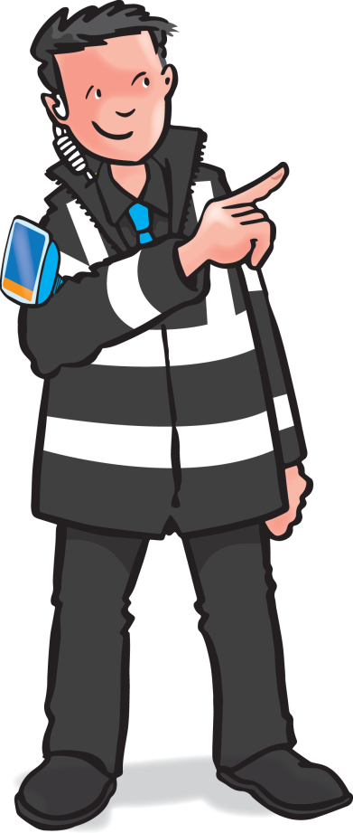
Application of physical intervention
skills in the private security industry
Notes:
This module covers:
physical interventions and the implications of their use
the risks associated with using physical intervention
reducing the risks associated with physical intervention
using physical intervention skills to protect yourself and others
using non-pain compliant standing, holding and escorting techniques

Slide 8
Learning outcomes - knowledge
1
Physical interventions and the implications
of their use
2
Risks associated with using physical intervention
3
Reducing the risks associated with
physical interventions.
Notes:
5 modules in total
Comprehensive tutor notes
Class discussion topics and class questions
Key tasks at the end of modules 1 - 3 should be answered by all learners simultaneously to ensure everyone understands before moving to the next module.

Slide 9
Learning outcomes - practical
4
Using physical intervention skills to protect yourself and others
5
Using non-pain compliant standing, holding and escorting techniques.
Notes:
5 modules in total
Comprehensive tutor notes
Class discussion topics and class questions
Key tasks at the end of each module should be answered by all learners simultaneously to ensure everyone understands before moving to the next module.

Slide 10
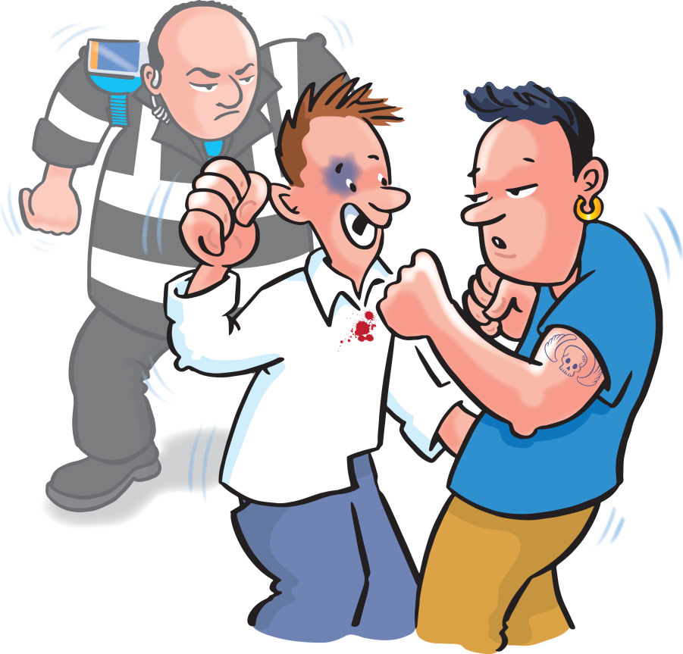

1
Physical interventions and
the implications of their use
Notes:
Completion of this module will enable learners to meet the following learning outcome:
Learning outcome 1: Understand physical interventions and the implications of their use
This includes assessment criteria:
1.1 State the legal implications of using physical intervention
1.2 State the professional implications of using physical intervention
1.3 Identify positive alternatives to physical intervention
1.4 Identify the differences between defensive physical skills and physical interventions
This module includes the following interactive activities:
class question: What is physical intervention?
class question: What can happen if force is used improperly?
Key task 1

Slide 11

What is physical intervention?
What is physical intervention?
Notes:
Class question: What is physical intervention?

Slide 12
Definition
Physical intervention is:
‘the use of direct or indirect force (bodily, physical or mechanical) to limit another person’s movement.’
Notes:
Class question answer
Some police forces encourage the use of handcuffs while others are strongly against security operatives’ possession or use of them.
Mechanical restraints include soft cuffs, plastic cuffs, ridged and chain link etc.
Know what is acceptable to be used in the area that you teach.

Slide 13
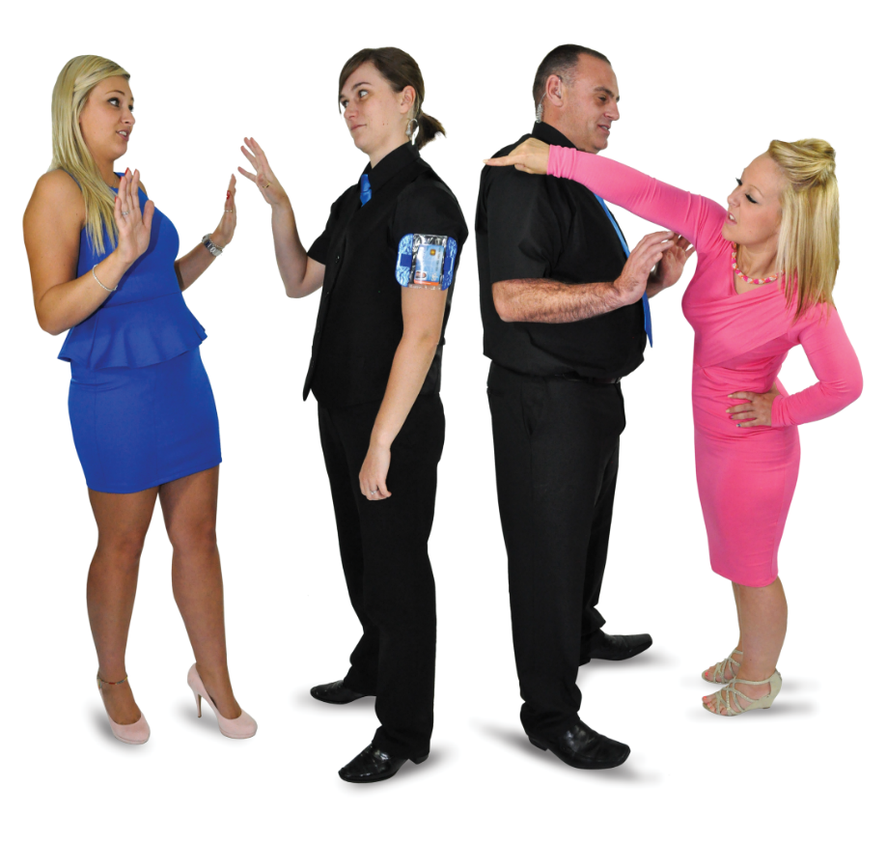
Techniques
On this course, you will only be taught techniques
that are:
non-restrictive
non-aggressive
low-level
non-pain compliant.
Notes:
Physical intervention should never be used as routine, to cause pain, out of spite, as a source of punishment or in any way that restricts a person’s breathing or impacts the airways. Furthermore, physical interventions should only be used when all other options have failed or are likely to fail, when it is not possible or appropriate to withdraw or when someone is in immediate risk of harm. Interventions should be used for no longer than is necessary and should cease as soon as the danger or incident is over.

Slide 14
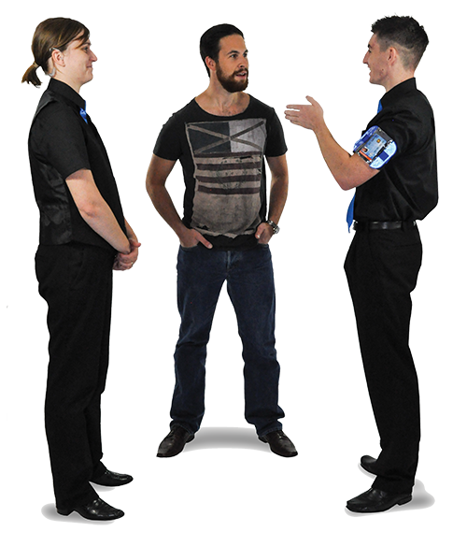
Non-restrictive techniques
Non-restrictive techniques include:
presence
directions
verbal and non-verbal
touching
prompting
guiding
disengagement.
Notes:
Non-restrictive techniques have no restraint of the person and usually involve no physical contact.

Slide 15
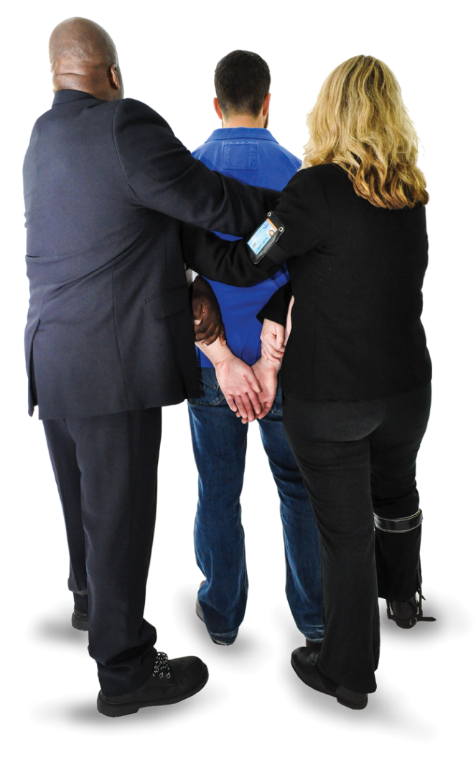
Restrictive techniques
Restrictive techniques include:
escorting
seclusion
physical containment
full restraint
mechanical restraint.
Notes:
Restrictive techniques restrict the movement of the person.

Slide 16
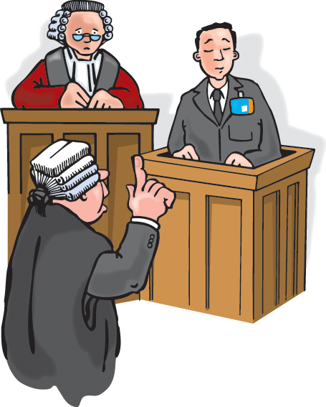
What can happen if force is used improperly?
The improper use of force could:
make the situation worse
spoil the team’s reputation
cause complaints
cause disciplinary proceedings
cause civil actions
cause criminal proceedings
result in loss of SIA license
result in injury or death.
Notes:
Class question: What can happen if force is used improperly?
Improper use of force could:
make the situation worse
spoil the team’s reputation
cause complaints
cause disciplinary proceedings
cause civil actions
cause criminal proceedings
result in loss of SIA license
result in injury or death.
No one should want the reputation of using excessive force.

Slide 17
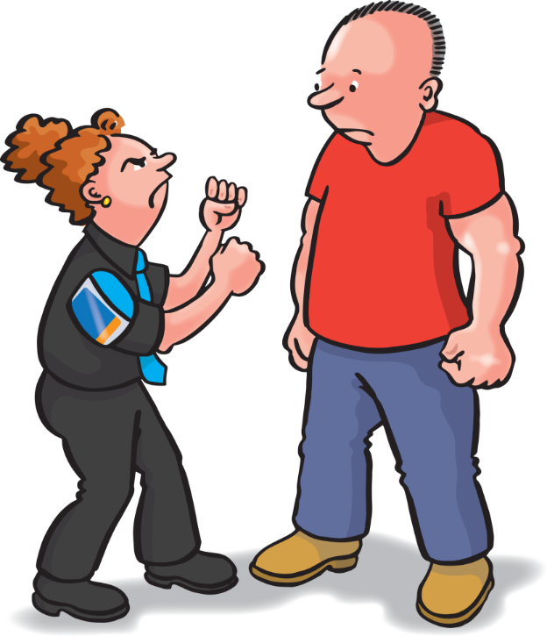
Last resort
Door supervisors should only use physical interventions as a last resort.

Slide 18

Physical intervention is used as a last resort
Normally only used to:
protect someone from a dangerous situation
break away or disengage from harmful contact
separate someone from a ‘trigger’
which is likely to set off a course
of events.
Notes:
Door supervisors should only use physical intervention as a last resort when verbal and non-verbal communication have not been successful or, for example, when customers are already fighting.

Slide 19
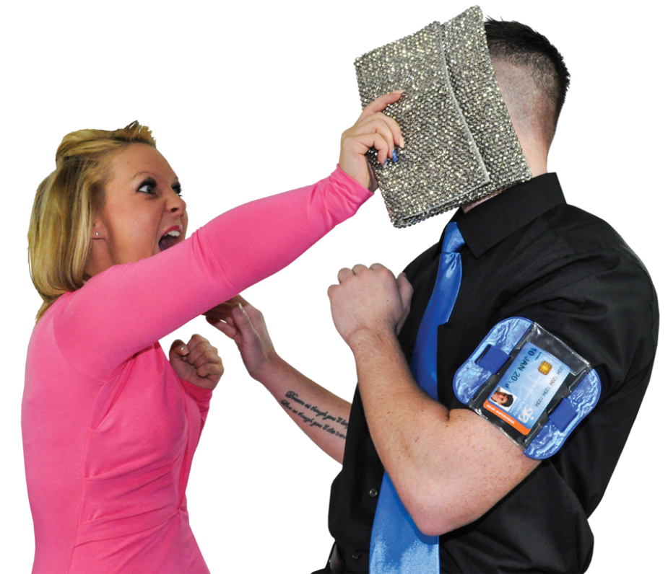
Legal implications
The authority for security operatives
to use force comes from:
  the Licensing Act 2003
  self-defence (common law)
  the Criminal Law Act 1967
  breach of the peace
You have an ethical duty to work within the law, without hurting the customers you are hired to protect.
Notes:
Explain to learners that unless they use the necessary constraints when dealing with unruly or violent customers, they may find themselves liable to an assault charge, a fine and/or claim for compensation. Working within the professional security sector, they must learn to carry out their duties without hurting the very customers they are hired to protect.

Slide 20

Trespass
A trespass is committed by a person who
is improperly on someone else’s property
without consent
The law says ‘no more force is used
than is necessary to remove the
trespasser from the premises’.
Notes:
Once a door supervisor has requested someone leaves the premises and they do not, they become a trespasser and can be removed by force if necessary (they will also be committing an offence under the Licensing Act 2003).
Explain to learners that under the rules of trespass, as a door themselves and others from attack. What the law does not allow is the excessive use of force or causing unnecessary or malicious injuries to any person.

Slide 21
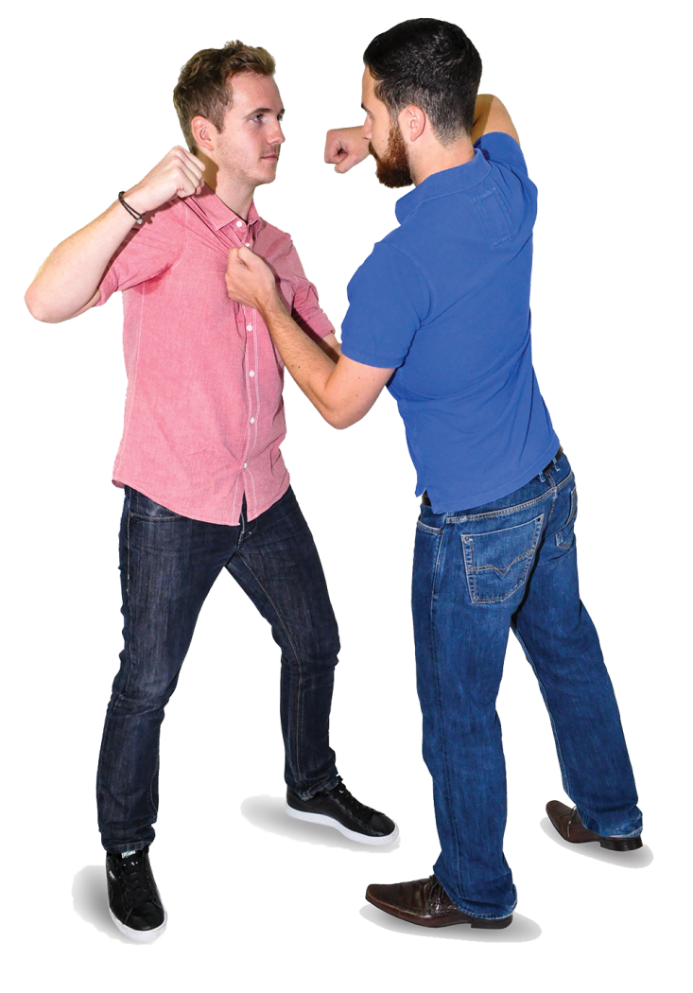
Self-defence (common law)
The rules of self-defence:
‘if any person has an honestly held
belief that he/she or another is in
imminent danger, then he/she may
use such force as is reasonable and necessary to avert that danger’.
Notes:
Common law but still in effect.
A person who is about to be attacked does not have to wait for their assailant to strike the first blow. Circumstances may justify a pre-emptive strike.

Slide 22
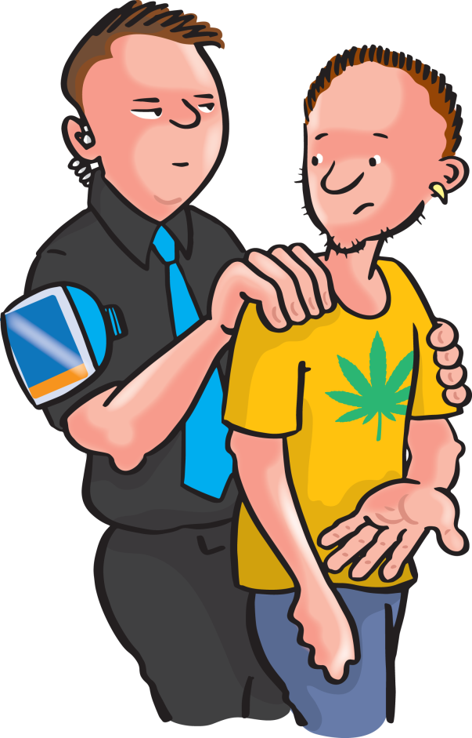
The Criminal Law Act
Sec. 3 Criminal Law Act, 1967
This act gives everyone, including
door supervisors, the authority to use
‘such force as is reasonable in the circumstances in the prevention of
crime, or in effecting (or assisting in)
the lawful arrest of offenders, suspected offenders or persons unlawfully at large’.
Notes:
The ‘prevention of crime’ element applies to any crime where the preventative use of force is reasonably required. This would include protecting property from damage or theft, and protecting people from physical injury.

Slide 23
Breach of the peace
Preventing a breach of the peace and saving life:
‘any person may use such force as is reasonable in the circumstances to prevent a breach of the peace or to save a life’.
Notes:
To be used with caution as not all breaches of the peace are indicatable offences.
The ‘to save a life’ aspect is appropriate, although stronger legislation is probably applicable in these circumstances.
Scotland
The Scottish definition of a breach of the peace is where any person (including a door supervisor) may arrest any person committing a breach of the peace. A breach of the peace is where something is done in breach of public order or decorum which might reasonably be expected to lead the lieges (public) being alarmed, upset or tempted to make reprisals at their own hand.

Slide 24
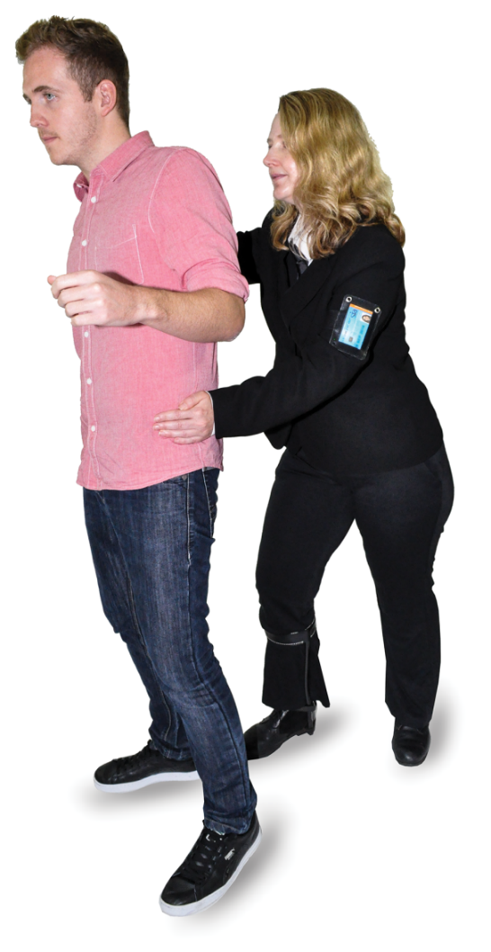
The use of force
Reasonable
Necessary
Pre-emptive strike
Justification.
Notes:
Reasonable depends on a jury’s perspective. Is being spat at a reason to punch someone?
Necessary – must be able to show escalation from the lowest reasonable use of force to the end level of force used.
Pre-emptive - strikes are legal under the correct circumstances, but the DS must be able to justify why they felt they needed to strike first.

Slide 25
Physical interventions
All physical interventions need to be justified, but obviously the higher level restrictive techniques will require higher levels of justification.

Slide 26
Justification
Was there a need to
use the force?
What was the size and build of the injured party compared to the door supervisor?
At what stage did the door supervisor stop using the force?
Was the force applied
in good faith or in a malicious way?
Notes:
The questions outlined in the slide are likely to be asked about any use of force.
Was there a need to use force?
Was it actually required or was this just a case of the customer irritating the DS who wanted to clear the venue quickly because they were tired?
What was the size and build of the injured party compared to the door supervisor?
Size and build is not about there being a big DS and small customer. It is about the amount of force used on a big, small, muscly, skinny customer. The minimum believed amount of force should be used first and then escalate if required.
At what stage did the door supervisor stop using the force?
Once outside of the venue, the DS would need a reason to continue restraining the person.
Was the force applied in good faith or in a malicious way?
If there is a reason that the DS may already not like the customer, e.g. previous manager that fired them, ex-boyfriend/girlfriend etc., then it would be more appropriate for a colleague to deal with this individual.

Slide 27
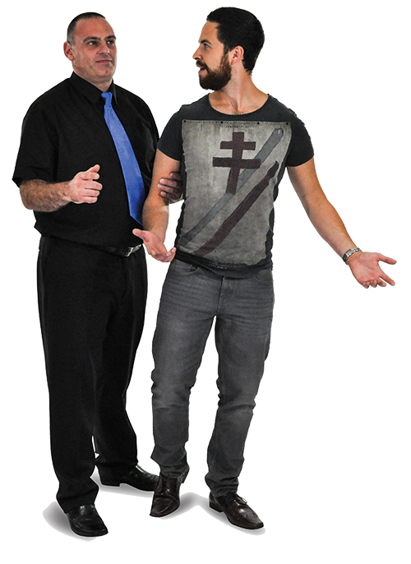
Justification
Was the amount of force reasonable or not?
What was the extent of the injuries compared to the amount of resistance given?
Were there any weapons used or threatened by the other party?
Notes:
The incident report should explain the need and level of force that was needed.
If a customer is compliant then there is no need to use force against them.
In a situation where a customer is in possession of weapons, such as knives or guns, this would not be considered a starting point for use of force. Door supervisors saving their own lives and that of customers and staff becomes the priority at this stage.

Slide 28
Other legislation
When considering the use
of physical intervention in the workplace, you also need to ensure that you do not accidentally or recklessly breach any other laws.
Notes:
Health & Safety at Work etc. Act 1974 has been covered in previous units.
Employment Rights Act is a new topic and is covered on the relevant slide.

Slide 29
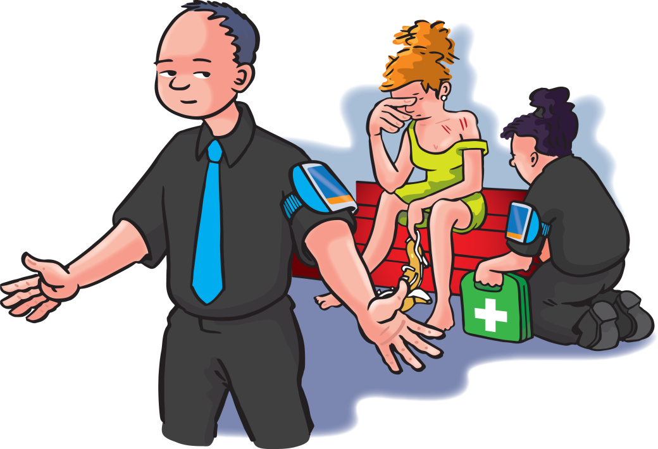
The Health and Safety at
Work etc. Act 1974
As a door supervisor, your responsibilities are to:
  take reasonable care of your own health and safety
  ensure that your own
  acts or omissions do not adversely affect the health and safety of others.

Slide 30

The Health and Safety at Work etc. Act 1974
As a door supervisor, you must:
follow health and safety policies provided and keep up to date
practise safe working habits
and obey all safety rules
use protective equipment properly
be aware of emergency procedures and ensure that they are followed when necessary.

Slide 31
The Employment Rights Act 1996
Section 44 of the Act protects employees from being disciplined or dismissed if they leave their place of work because they think they are under serious threat of attack
It also allows them to take appropriate measures to protect themselves and others from danger.
Notes:
This does not mean that a DS can start a fight and then go and hide in the toilets. It does however mean that no DS is expected to run into the middle of 20 people fighting to try to stop them.
It is expected that door supervisors wait for backup from colleagues or the police and remove the customers one by one from the outside of the crowd.

Slide 32
Professional implications
As well as abiding by the various laws in relation to using force in the workplace, door supervisors must:
be aware of the professional implications relating to the use of physical intervention
familiarise themselves with any sector specific and professional guidance and standards relevant to their area of employment, e.g. working in a prison or health and social care.
The SIA also publishes guidance documents periodically.

Slide 33
Duty of care: Monitoring the person’s safety
During all physical interventions, it is vital that you talk to and listen to the person being restrained, and manage and monitor their safety
Specifically, you need to ensure that nothing impedes the person’s ability to breathe or their circulation.
Notes:
Door supervisors have a legal duty of care for all customers.
Consider the possible effects of drink, drugs and pre-existing injuries that might increase the potential complications of using PI on an individual.
Know the availability of first aid/other partners, e.g. street pastors/angels.
Take advice from the first-aider regarding the need for an ambulance. The DS should know if the police need to be called.

Slide 34
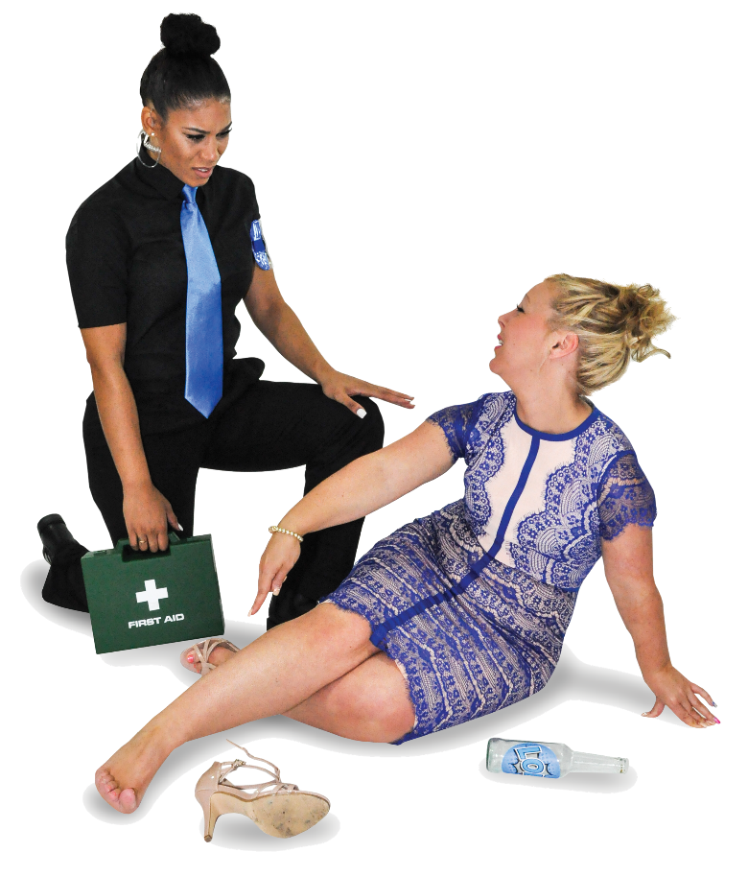
Monitoring the person’s safety cont.
Signs that a person may be having difficulties include:
effort with breathing
blocked airway and/or vomiting
passivity or reduced
consciousness
being non-responsive
signs of head or spinal injury
facial swelling
evidence of alcohol or drug
overdose.
Notes:
All of the above could be signs that the person is dying and should be treated as a medical emergency.

Slide 35
Duty of care- monitoring the person’s safety
blueness around the lips, face
or nails (signs of asphyxia)
complaining of difficulty breathing
high body temperature, sweating/hot skin
exhaustion
confusion, disorientation and incoherence
hallucinations, delusions, mania, paranoia
bizarre behaviour
extreme fear
high resistance and abnormal strength.
Notes:
It has been proven that the previously accepted theory that if a person can speak then they can breathe is not true. People have died while in the process of speaking.

Slide 36
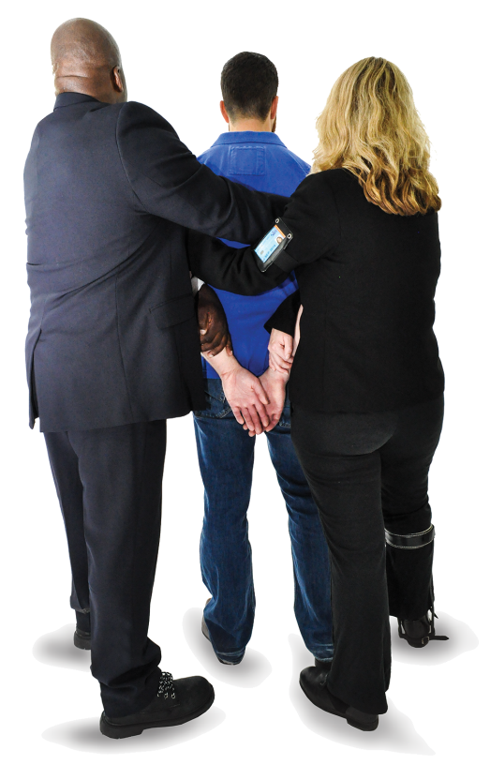
Signs of difficulties
Remember
The longer the restraint is used for, the greater the exposure to risks and complications.
Notes:
The longer the restraint is used for, the greater the potential of permanently hurting the person or them dying.

Slide 37
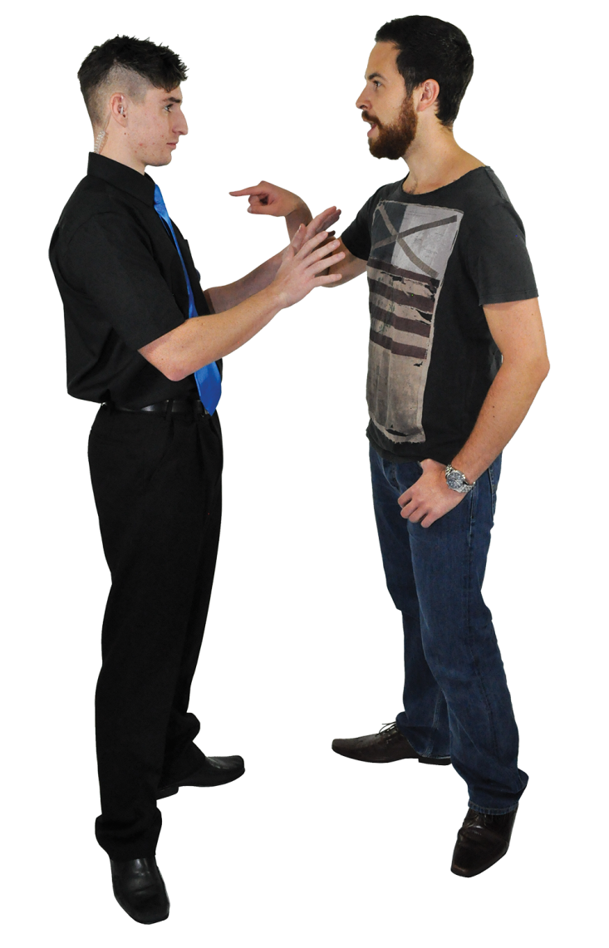
Positive alternatives to physical intervention
Primary controls
Secondary controls.
Notes:
Explained on the next slides.

Slide 38
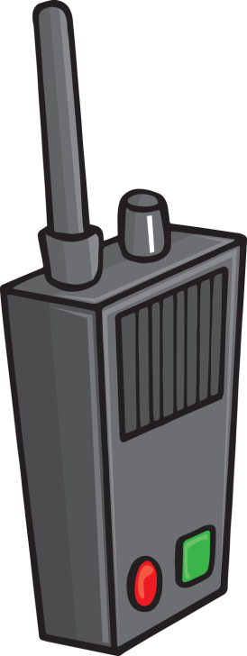
Primary controls
Following employer’s security and safety policies, procedures and working practices (use of safety and security)
Proper, regular, ongoing workplace risk assessments
Equipment and technology e.g. CCTV, radios, access control
Positive and proactive service delivery.
Notes:
Essentially anything that is at the workplace before you arrive.

Slide 39
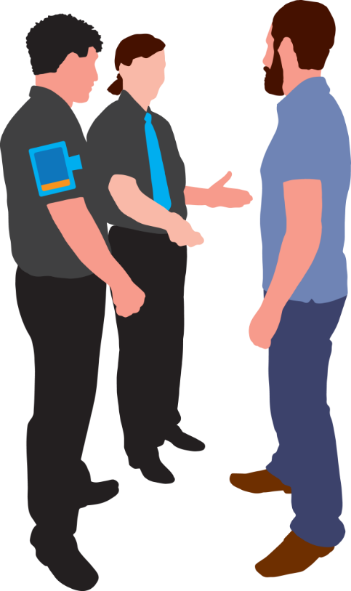
Secondary controls
Positive and effective communication skills
Deterrents through staff presence
Conflict management skills
Early interventions
Diversion
Redirection
Switching
Passing the baton
Seclusion.
Notes:
The DS, their presence and conflict management skills.

Slide 40
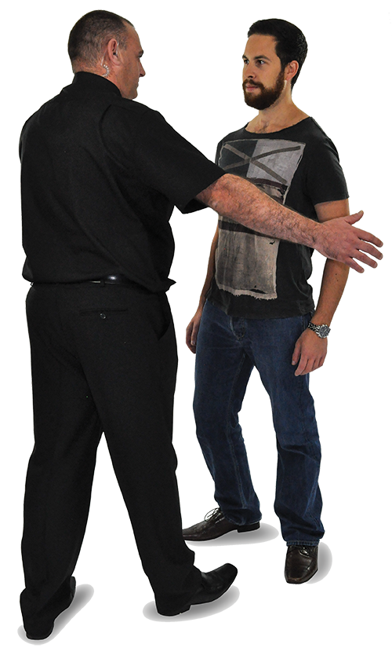
Defensive physical skills
Defensive physical skills are methods
used to try to prevent yourself getting
into problems in the first place.
Notes:
Commonly called conflict management skills.

Slide 41

Defensive physical skills cont.
Defensive physical skills enable
you to:
recognise danger
avoid it
manage it
react to it safely
Usually involving no use of force.
Notes:
Early response usually makes the management of the situation easier.

Slide 42
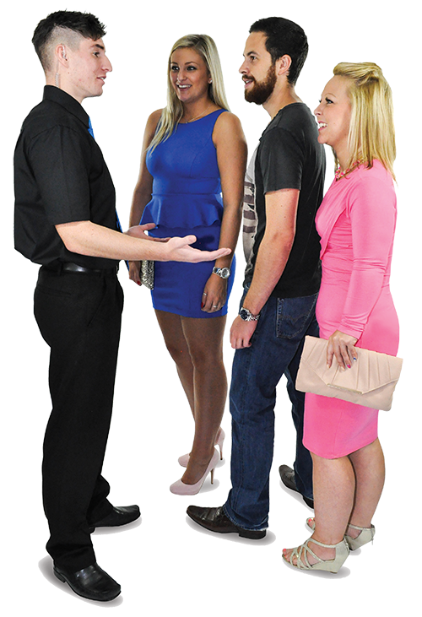
Defensive physical skills cont.
Defensive physical skills include:
risk assessments
calling for support
position
stance
communication skills
boundaries
barriers
exit routes.
Notes:
Already covered in conflict management.

Slide 43
Physical intervention
Physical intervention skills enable
you to:
protect yourself
protect others
escort people away from incidents
Using low levels of force.
Notes:
Low levels of force being verbal or guiding, use of body language.

Slide 44
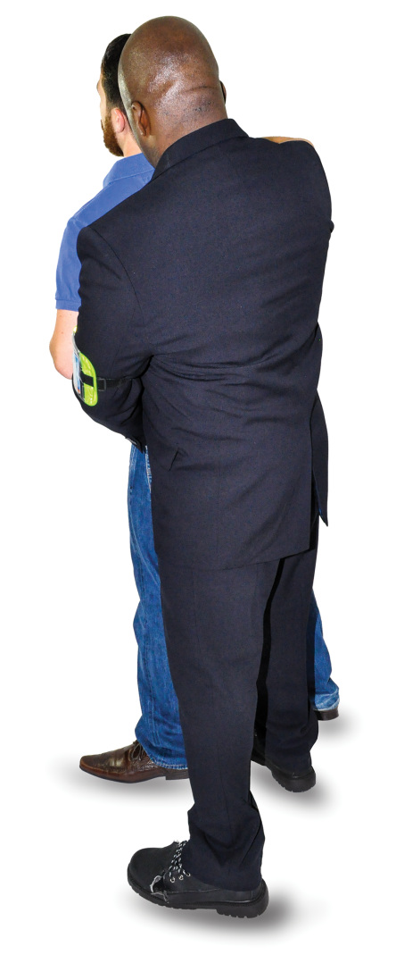
Physical intervention
Physical intervention skills include:
guides
deflections
blocks
escorting holds
disengagement techniques
restraints.

Slide 45

Key Task 1
1
Match the statements to the correct answer
(place the number of the answer in the circle provided).
Trespass is...
...stopping
people shouting
at each other
...being on someone
else’s property
without consent
...any door
supervisor
using force
2
3
1
...as a last
resort
...criminal
proceedings
Using physical
Interventions incorrectly can lead to...
...with the
other person’s
permission
5
6
4
...civil action
...illegal
Physical
interventions should
only be used...
...entering property
unannounced
10
8
...at weekends
7
9
Notes:
Ask delegates to complete the key tasks for this section in their handouts, or to complete it in groups in the classroom.

Slide 46

Key Task 1
1
Match the statements to the correct answer
(place the number of the answer in the circle provided).
Trespass is...
...stopping
people shouting
at each other
...being on someone
else’s property
without consent
...any door
supervisor
using force
2
3
1
...as a last
resort
...criminal
proceedings
Using physical
Interventions incorrectly can lead to...
...with the
other person’s
permission
5
6
6
4
...civil action
...illegal
Physical
interventions should
only be used...
...entering property
unannounced
10
8
...at weekends
7
5
9

Slide 47
Key Task 1
2
Explain what physical intervention is.
.................................................................................................................. ..................................................................................................................
..................................................................................................................
..................................................................................................................
..................................................................................................................
Notes:
Ask delegates to complete the key tasks for this section in their handouts, or to complete it in groups in the classroom.

Slide 48
Key Task 1
2
Explain what physical intervention is.
The use of direct or indirect force (bodily, physical or mechanical) to limit another person’s movement.
.................................................................................................................. ..................................................................................................................
..................................................................................................................
..................................................................................................................
..................................................................................................................

Slide 49
Key Task 1
3
Identify positive alternatives
to physical intervention.
.................................................................................................................. ..................................................................................................................
..................................................................................................................
..................................................................................................................
..................................................................................................................
Notes:
Ask delegates to complete the key tasks for this section in their handouts, or to complete it in groups in the classroom.

Slide 50
Key Task 1
3
Identify positive alternatives
to physical intervention.
Primary and secondary controls.
.................................................................................................................. ..................................................................................................................
..................................................................................................................
..................................................................................................................
..................................................................................................................

Slide 51
2
Risks associated with using
physical intervention
Notes:
Completion of this module will enable learners to meet the following learning outcome:
Learning outcome 2: Understand the risks associated with using physical intervention
This includes assessment criteria:
2.1 Identify the risk factors involved with the use of physical intervention
2.2 Recognise the signs and symptoms associated with acute behavioural disturbance (ABD) and psychosis
2.3 State the specific risks associated with positional asphyxia
2.4 State the specific risks associated with prolonged physical interventions
This module includes the following interactive activities:
class question: What other factors should be considered when using physical interventions?
Key task 2

Slide 52
Risk factors
Whenever force is used on another person, there is always the risk of injury
Proper training and care when applying the techniques will help reduce the risk of hurting the person
Extra considerations needs to be given to:
which techniques are used
how techniques are used
how long techniques are applied.

Slide 53
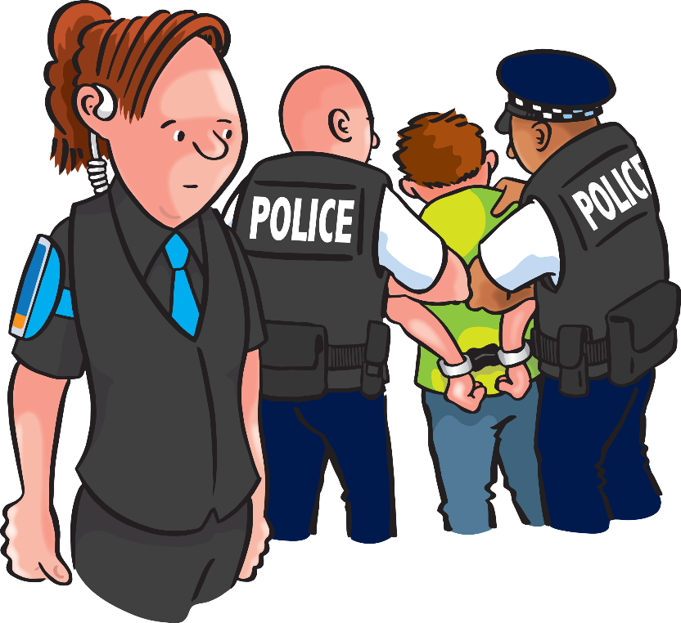
Nature of restraints
The following must be considered:
method of restraint (bodily or mechanical, standing or walking can increase the likelihood of trips and falls)
position held (consider positional asphyxiation)
duration of the restraint (the longer the time of restrain the higher the likelihood
of injuries).

Slide 54
Situational factors
Location - open, crowded, confined, standing , ground
Environmental – wet, ice, uneven surfaces outside the venue
Number of staff, location of the team (are they dealing with another incident)
No team – the one DS venue
Access to medical attention (ambulance or first aid)
Threats from others, e.g. partners, friends, good Samaritans
Options available to you (remember TACT and SEW from the conflict unit).
Notes:
Door supervisors should always consider their own safety and that of their team.

Slide 55
What other factors should be considered when using physical interventions?
Existing physical injuries
Size
Age
Physical state (medication,
condition, exhaustion, recent
ingestion of food, alcohol, drugs)
Mental health (history of violence,
prior experience of abuse and trauma).
Notes:
Class question: What other factors should be considered when using physical interventions?
In most cases, we do not actually know a customer’s history.
Obvious responses and visual indications should be considered when applying force.
The young may not have fully calcified bones and the old may have brittle bones etc.

Slide 56
Vulnerable groups
Vulnerable groups include:
children and young people
older adults
individuals with mental health issues
You should always try to use conflict
managements skills as a primary de-escalation
technique when working with vulnerable groups.

Slide 57
Acute behavioural disturbance (ABD)
ABD is a medical emergency that can be caused by:
  head injuries
  tumours
  high temperature
  heat exhaustion
  high or low blood pressure
  anti-psychotic drug abuse.

Slide 58
Acute behavioural disturbance
(ABD) cont.
Subjects suffering from ABD often have incredible strength and do not feel pain
They can die suddenly of cardiac arrest if not treated quickly
They are often at greater risk from positional asphyxia when being physically restrained.

Slide 59
Signs and symptoms of ABD
ABD is a term used to cover a combination of physical and psychological factors such as:
high temperature (skin feels hot to the touch)
bizarre behaviour
sustained mental and physical exhaustion
and metabolic acidosis.
Notes:
Everyone to consider that if a person is trying to remove their clothes and the skin is hot to the touch, it may be that the person has ABD and an ambulance will be required immediately, in addition to the police.

Slide 60
Signs and symptoms of ABD
Features of ABD include:
extreme agitation
excitability
paranoia
great strength
aggression and resistance to pain-compliance techniques.

Slide 61
Psychosis
Can be as a result of underlying mental illness or may
be drug induced
May result in hallucinations, paranoia or extreme fear
as a part of delusional belief
Can lead to sudden death and should be treated as a medical emergency.

Slide 62
Psychosis cont.
ABD and psychosis can result in sudden death
Both should be treated as medical emergencies
Use de-escalation (verbal and non-verbal communication, distraction and calming
techniques) as appropriate to the situation.

Slide 63
Positional (or restraint) asphyxia
Positional asphyxia is anything that prevents the ribcage from being able to move in and out and therefore prevents the diaphragm from raising up and down
Positional asphyxia typically occurs during forceful restraint resulting in weight or pressure on the torso
Whilst all forceful restraints on the ground carry a heightened risk, the techniques used will increase or decrease the risks of positional asphyxia.

Slide 64
Positional (or restraint) asphyxia
Positional (or restraint) asphyxia can occur when:
being held forcefully face up or face down on the floor or any other surface, e.g. bed
in a seated position, e.g. slumped forward
being sat on (chest or back)
in a standing position using methods that compromise breathing, e.g. chicken wing, bent over or forced against a wall/object
The longer the restraint is used, the more likely the potential of harm, including death.

Slide 65
Key Task 2
1
List 3 situational factors and 3
individual factors when using
physical intervention.
…...........................................
...............................................
...............................................
1
…...........................................
...............................................
...............................................
1
2
2
3
3
Notes:
Ask delegates to complete the key tasks for this section in their handouts, or to complete it in groups in the classroom.

Slide 66
Key Task 2
1
List 3 situational factors and 3
individual factors when using
physical intervention.
…...........................................
...............................................
...............................................
...............................................
...............................................
1
…...........................................
...............................................
...............................................
1
Threats from others e.g. partners,
friends, good Samaritans
Existing physical injuries
2
Size
2
Number of staff
3
Age.
3
Options available to you – remember
TACT and SEW from your conflict unit

Slide 67
Key Task 2
2
What are the 3 signs and symptoms
of acute behavioural disturbance (ABD)?
…..................................................................................................................................................................................................................................................................................................................
1
2
3
Notes:
Ask delegates to complete the key tasks for this section in their handouts, or to complete it in groups in the classroom.

Slide 68
Key Task 2
2
What are the 3 signs and symptoms
of acute behavioural disturbance (ABD)?
…..................................................................................................................................................................................................................................................................................................................
1
High temperature
2
Bizarre behaviour
3
Sustained mental and physical exhaustion.

Slide 69
Reducing the risks associated
with physical intervention
3
Notes:
Completion of this module will enable learners to meet the following learning outcome:
Learning outcome 3: Understand how to reduce the risks associated with physical intervention
This includes assessment criteria:
3.1 State the specific risks of dealing with physical intervention incidents on the ground
3.2 Identify how to deal with physical interventions on the ground appropriately
3.3 Identify ways of reducing the risk of harm during physical interventions
3.4 State the benefits of dynamic risk assessment in situations where physical intervention is used
3.5 State how to manage and monitor a person’s safety during physical intervention
3.6 State the responsibilities of all involved during a physical intervention
3.7 State the responsibilities immediately following a physical intervention
3.8 State why it is important to maintain physical intervention knowledge and skills
This module includes the following interactive activities:
class question: What are your responsibilities immediately following a physical intervention?
class question: Why is it important to keep physical intervention skills up to date?
Key task 3

Slide 70
Physical intervention incidents on the ground
Restraint-related deaths are more common during ground restraints. Therefore, they should be avoided
if at all possible
Where the potential for ground restraints is high, employers and venue operators must:
properly assess the risks relating to this
implement control measures
provide guidance as well as any additional
training required.
Notes:
All ground holds are high-risk. These must be avoided unless absolutely necessary.

Slide 71
Physical intervention incidents on the ground cont.
Deaths can occur when a person is forcefully held face up or face down
During forceful takedowns/falls to the ground, you are also at risk. You should consider:
avoiding takedowns
if possible
glass/other debris
that you are vulnerable
to assault
monitoring the person’s breathing
getting the person back up into a seated/recovery position ASAP.

Slide 72
Dealing with physical intervention incidents on the ground appropriately
Use more than one door supervisor
One door supervisor should take responsibility for person’s safety
Maintain dialogue
Try to de-escalate
Reduce force as soon as you can
Cease restraint in medical emergency
(their breathing becomes laboured or stops).

Slide 73
Types of harm on the ground
Serious injury or death can result from:
strikes and kicks
an individual falling or being forced to the ground
interventions involving the neck, spine or vital organs
restraint on the ground (face up or down) or other positions
that impair breathing or circulation
any forceful restraint
stress and emotional trauma (especially for those who have experience of abuse and trauma)
You must respect the dignity of the individuals you are managing however challenging you may find them.

Slide 74
Reducing the risk of harm
Choose the least forceful intervention practicable
Avoid high-risk positions, including ground restraints
Avoid high-risk methods or restraints, such as neck holds or any hold that can adversely affect breathing
or circulation
Maintain ongoing communication with colleagues during and following the restraint
Monitor the well-being of the subject for adverse reactions.

Slide 75
Reducing the risk of harm
Work as a team and designate a team leader
Follow procedures
De-escalate at the earliest opportunity
Immediately release and provide support if subject shows signs of breathlessness or adverse reactions.

Slide 76
Definition
Risk assessment:
‘the continuous assessment of risk in the rapidly changing circumstances in the workplace or during an incident, in order to implement the control measures necessary to improve safety’.
Notes:
Already discussed in conflict.

Slide 77
Dynamic risk assessment
Think ‘safety’ first
When dealing with any incident where there is the risk of physical harm, door supervisors should use the ‘TACT’ model before acting.
Assess the situation
Consider your options
Take action
Notes:
Already discussed in conflict.

Slide 78
Dynamic risk assessment
When assessing the situation, door supervisors should
use the ‘SEW’ model to look for specific threats.
Subjects
Environment
Weapons
Notes:
Already discussed in conflict.

Slide 79
Safety during physical intervention
You must monitor a person’s safety while using physical intervention techniques
This can be done by:
fully observing the risk factors (situational and individual)
ensuring that nothing impedes the subject’s circulation or ability to breathe (checking airway, breathing, circulation (ABC)).

Slide 80
Safety during physical intervention cont.
Actions to take:
if the person is unconscious, but is breathing and has no other life-threatening conditions, place them in the recovery position
commencing CPR/defibrillator should only be performed when a person shows no signs of life or when they are unconscious, unresponsive and not breathing or not breathing normally (in cardiac arrest, some people will take occasional gasping breaths, however, they still need CPR.

Slide 81
Safety during physical intervention cont.
If the person is breathing and conscious, talking and listening to the subject, taking them seriously and acting on their concerns, especially if they say they are struggling to breathe, as people can still speak when experiencing positional asphyxia or other forms of medical distress.
Notes:
It is important to stress to learners that they must talk and listen to the subject, take them seriously and act on their concerns, especially if they say they are struggling to breathe, as people can still speak when experiencing positional asphyxia or other forms of medical distress.

Slide 82
Acting on ‘red flags’
You must act on any signs of danger (‘red flags’) during any type of physical intervention. A ‘red flag’ could be:
effort with/difficulty inbreathing
blocked airway and/or vomiting
passivity or reduced consciousness
being non-responsive
signs of head or spinal injury
facial swelling.

Slide 83
Acting on ‘red flags’ cont.
Blueness around the lips, face or
nails (signs of asphyxia)
High body temperature, sweating/hot skin
Exhaustion
Confusion, disorientation and incoherence
Hallucinations, delusions, mania, paranoia
Bizarre behaviour
Extreme fear
High resistance and abnormal strength.

Slide 84
Acting on ‘red flags’ cont.
If you think you see any of these ‘red flags’ then employ
de-escalation techniques (calming or distraction) and call
a first-aider/emergency service immediately
You must provide emergency services with the following briefing:
anything known about the person that may help their assessment and treatment
details of any restraint including the method and duration.

Slide 85
Responsibilities during a physical intervention
All staff involved in a physical intervention have the following responsibilities to ensure the safety of persons during and after the intervention:
duty of care to the subject at all times
(during and after restraint)
duty of care to colleagues
respecting the dignity of the subject
providing appropriate care for any person
who appears to be injured or at risk
challenging unnecessary and excessive use
of force by colleagues.
Notes:
Even though someone may have been aggressive towards you or another person, you still always have a duty of care and a responsibility to be the better person.

Slide 86
Supporting colleagues during a physical intervention
Switch roles with the team
where appropriate
Monitor staff safety
Monitor the subject and inform colleagues if you have any concerns for their well-being
Contain the immediate area
and manage bystanders
Monitor the situation and communicate with others, e.g. staff from other agencies such as the police or ambulance service.

Slide 87
What are your responsibilities immediately following a physical intervention?
Duty of care to the subject at all times
Duty of care to colleagues
Provide appropriate care for any person who appears to be injured or at risk
Briefing emergency services about the circumstances, position, duration and any difficulties experienced in a restraint event
Preserving evidence and securing witness testimony
All staff involved must complete a full report individually accounting for their actions.
Notes:
Class question: What are your responsibilities immediately following a physical intervention?
Discuss any additional points raised.
Examples may include:
duty of care to the subject at all times (during and after restraint)
duty of care to colleagues
provide appropriate care for any person who appears to be injured or at risk
briefing emergency services about the circumstances, position, duration and any difficulties experienced in a restraint event
preserving evidence and securing witness testimony
all staff involved must complete a full report individually accounting for their actions

Slide 88
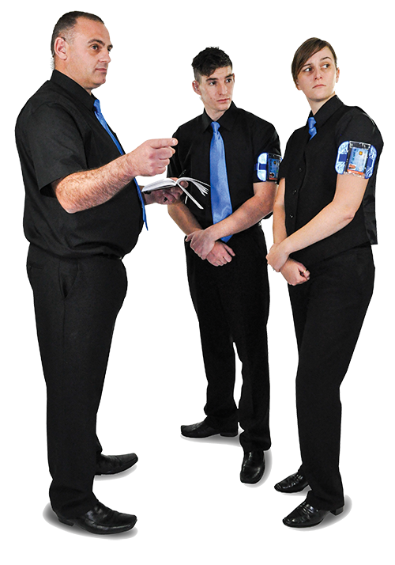
Why is it important to keep physical intervention skills up to date?
Remain effective
Remain safe
Legally up to date to prevent possible civil and criminal proceedings
Keep motor/physical skills up to date
Health and safety implications
Keep your physical intervention skills refreshed by regularly practicing with
other individuals.
Notes:
Class question: Why is it important to keep physical intervention skills up to date?
Remain effective
Remain safe
Legally up to date to prevent possible civil and criminal proceedings
Keep motor/physical skills up to date
Health and safety implications
Keep your physical intervention skills refreshed by regularly practicing with other individuals.

Slide 89
Key Task 3
1
Explain how to deal with physical
intervention on the ground.
.................................................................................................................. ..................................................................................................................
..................................................................................................................
..................................................................................................................
..................................................................................................................
Notes:
Ask delegates to complete the key tasks for this section in their handouts, or to complete it in groups in the classroom.

Slide 90
Key Task 3
1
Explain how to deal with physical
intervention on the ground.
Avoid takedowns if possible
Get the person back up or to a seated position as soon
as possible
Monitor the persons breathing
Speak to the person
Try to de-escalate as soon as possible.
.................................................................................................................. ..................................................................................................................
..................................................................................................................
..................................................................................................................
..................................................................................................................
..................................................................................................................

Slide 91
Key Task 3
2
Explain when dynamic risk
assessments should be used.
.................................................................................................................. ..................................................................................................................
..................................................................................................................
..................................................................................................................
..................................................................................................................
Notes:
Ask delegates to complete the key tasks for this section in their handouts, or to complete it in groups in the classroom.

Slide 92
Key Task 3
2
Explain when dynamic risk
assessments should be used.
Before you start to deal with a situation.
.................................................................................................................. ..................................................................................................................
..................................................................................................................
..................................................................................................................
..................................................................................................................

Slide 93
4
Using physical intervention skills
to protect yourself and others
Notes:
Completion of this module will enable learners to meet the following learning outcome:
Learning outcome 4: Be able to use physical skills to protect yourself and others
This includes assessment criteria:
4.1 Demonstrate stance and positioning skills
4.2 Demonstrate skills used to evade and protect against blows
4.3 Demonstrate methods of disengagement from grabs and holds
4.4 Demonstrate non-aggressive intervention methods to stop assaults or fights
4.5 Communicate professionally throughout the physical intervention

Slide 94
Practical training
By the end of your practical training in the classroom, you will need to be able to demonstrate to the instructor that you can perform the following:
stance and positioning skills
evade and protect blows
methods of disengagement from grabs and holds
at least 2 methods to intervene in a violent situation (minimum 1 individual method and 1 team method).

Slide 95
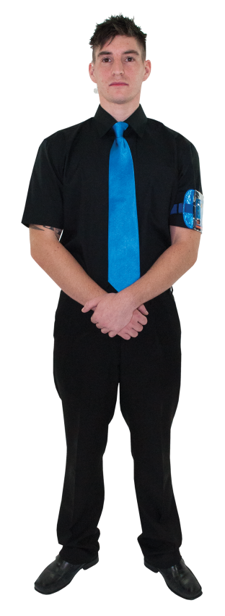
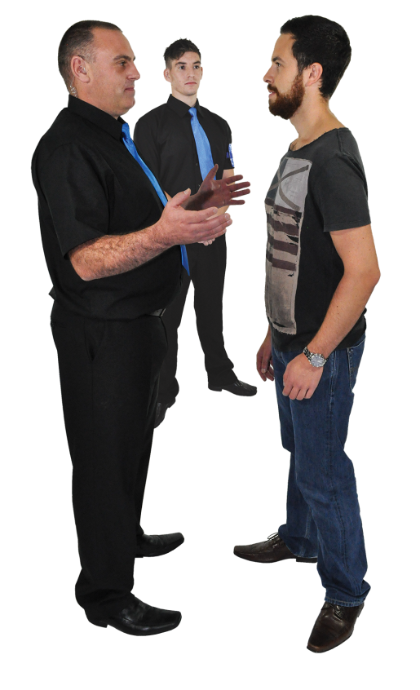
Practical training cont.
You will also need to demonstrate that you can communicate professionally with the subject, colleagues and others while protecting yourself and others from assault, in line with conflict management training.

Slide 96
Practical training cont.
You must use calm and reassuring verbal and non-verbal communication to:
calm and reassure the person under restraint
others present
check the understanding with the person in the restraint
check the physical and emotional well-being
of the person restrained
negotiate and manage safe de-escalation with the person restrained and the staff involved.

Slide 97
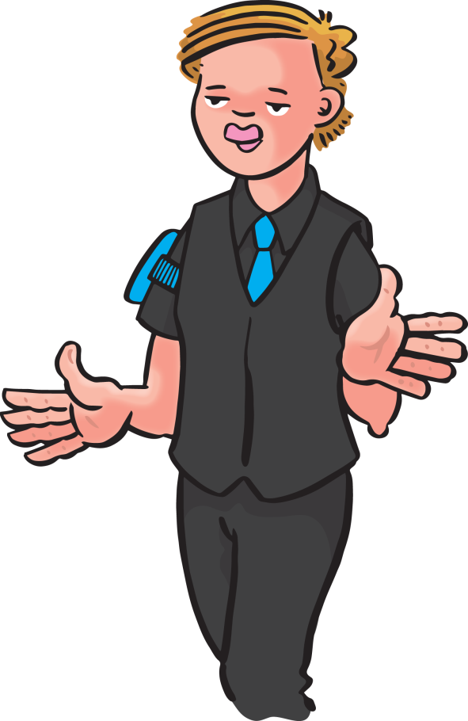
5
Using non-pain compliant standing,
holding and escorting techniques
Notes:
Completion of this module will enable learners to meet the following learning outcome:
Learning outcome 5: Be able to use non-pain compliant standing, holding and escorting techniques
This includes assessment criteria:
5.1 Demonstrate how to physically prompt a person
5.2 Demonstrate low-level restrictive standing holds that can be used to escort an individual
5.3 Demonstrate low-level restrictive standing one and two person holds that can be used to escort an individual
5.4 Demonstrate transitions between disengagement techniques and escorting techniques
5.5 Demonstrate how to escort an individual on stairways
5.6 Demonstrate how to disengage safely
5.7 Demonstrate how to manage risk immediately following disengagement

Slide 98
Practical training
By the end of your practical training in the classroom, you will need to be able to demonstrate to the instructor that you can perform the following:
a method for a non-restrictive prompt for use when verbal and non-verbal persuasion has not or is not likely to achieve the legitimate objective
a low-level method of escorting a person (1 and 2 person holds, in motion not just static)
restrain and escort a violent person (1 and 2 person holds, in motion not just static in the approved programme).

Slide 99
Practical training
move from disengagement from a defence block into a restraint/escorting move
provide support to colleagues during a physical intervention
de-escalate and disengage a physical intervention ensuring the safety of all parties
Escort an individual on stairways either because they are:
  intoxicated or ill and require assistance or
  non-compliant and need to be moved
Disengage safely, de-escalating the level of hold, using positive communication to inform and reassure the person, move to a safe distance away from the person.

Slide 100
Practical training cont.
Manage the risk immediately following disengagement, reduce risks of assault to staff and bystanders during and immediately after disengagement of the restraint through:
  creating space
  positive communication with colleagues and other people present
  safe handover to others, e.g. police or ambulance personnel detailing any risk behaviours presented by the person, method and duration of restraint used and any concerns you may have for their well-being.

Slide 101
The next few slides are for you to add your own
standing, holding and escorting techniques.

Slide 102
Technique 1

Slide 103
Technique 2

Slide 104
Technique 3

Slide 105
Technique 4

Slide 106
Technique 5

Slide 107
Technique 6

Slide 108
Technique 7

Slide 109
Technique 8

Slide 110
Technique 9

Slide 111
Technique 10

Slide 112
Technique 11

Slide 113
Technique 12

Slide 114
Technique 13

Slide 115
Technique 14

Slide 116
Technique 15

Slide 117

The important things to do now are…
    to put into practice what you have learnt
1
2
  to develop competency in your work activities
3
  to keep your knowledge up to date
4
  to pass the examination.
Thank you for listening

