Slide 1
Working as a
Door Supervisor
Refresher
Notes:
Module 2: Principles of Working as a Door Supervisor in the Private Security Industry
This training presentation covers the learning outcomes and assessment criteria for module 2: Principles of Working as a Door Supervisor in the Private Security Industry (level 2 Award for Door Supervisors in the Private Security Industry qualification).

Slide 2

Ground rules
Fire escapes
Toilets
Smoking
Drinks
Breaks
Lunch
Questions
Talking over others
Respect others’ points of view
Timekeeping
Notes:
This can be made interactive by encouraging delegates to suggest ground rules.
Examples may include:
confidentiality/anonymity or at least not mentioning names
being open
participating

Slide 3
Module guide
1:1
Conducting effective search procedures
1:2
Terrorism
1:3
Keeping vulnerable people safe
1:4
Spiking Drink
Notes:
7 modules in total
Comprehensive tutor notes
Class discussion topics and class questions
Key tasks at the end of each module should be answered by all learners simultaneously to ensure everyone understands before moving to the next module.

Slide 4


1.1
Conducting effective search procedures
Notes:
Completion of this module will enable learners to meet the following learning outcome:
Learning outcome 2: Know how to conduct effective search procedures
This includes assessment criteria:
2.1 State the different type of searches carried out by a door supervisor
2.2 Identify a door supervisor’s right to search
2.3 Identify the different types of searching equipment
2.4 Recognise possible hazards when conducting a search
2.5 State the precautions to take when carrying out a search
2.6 State the actions to take if an incident or an accident occurs
2.7 Demonstrate how to search people and their personal possessions
2.8 Identify the reasons for carrying out a premises search
2.9 Recognise actions to take in the event of a search refusal
2.10 Identify reasons for completing search documentation
2.11 Identify actions to take if a prohibited or restricted item is found during a search
This module includes the following interactive activities:
group exercise: Search demonstration/practical activity
Key task 2

Slide 5

Rights to search
Door supervisors, as private members of the public, have no legal or statutory right to search any person without permission
KEY POINT
It is most important, therefore, that security
officers actually obtain permission from a person
they wish to search (beforehand.)
Notes:
As a door supervisor, you are still a private member of the public and therefore have no legal or statutory right to search any person without permission.
It is most important, therefore, that you obtain permission (beforehand) from a person you wish to search.
Under no circumstances can you forcibly search someone.

Slide 6
Searching without permission
Searching someone without the necessary consent could result in:
criminal proceedings for assault being taken against the security officer
civil action (compensation) being taken out against
the security officer and/or the security company
a criminal case against a person committing a crime failing, because the search that found the evidence was illegal as consent was not obtained.
Notes:
Searching without permission/consent could result in:
criminal proceedings for assault being taken against the security officer
civil action (compensation) being taken out against the security officer and/or the security company
a criminal case against a person committing a crime failing, because the search that found the evidence was illegal as consent was not obtained

Slide 7

Types of search
Your venue’s search policy
may require you to search:
people (and/or their bags) on entry
people already inside the premises
the premises (specific rooms or the whole building).
Notes:
Signage stating that searching may occur must be displayed at the entrance points.
The types of searches you will undertake as a door supervisor will be dependent on the types and potential customers of premises at which you work.

Slide 8
Searching people
As part of a venue’s admissions policy people may need
to be searched before entry to stop them from brining in any:
weapons
drugs
suspect packages
other unauthorised items
KEY POINT
Weapons are items that are made, adapted or intended to be used to cause injury to another person.
Notes:
Searching people
People may need to be searched before entering a site as a condition of entry, or before leaving it.
They might require searching to stop them from bringing any weapons, drugs, suspect packages or other unauthorised items on to the site, or they may need searching before they leave to ensure that they are not accidentally or deliberately taking away any of the client’s property with them.

Slide 9

Types of search
When and how often to search
Searches may be:
GENERAL
RANDOM
SPECIFIC.
Notes:
When and how often to search
Some sites will have a policy where every visitor is searched prior to entry (GENERAL), whereas others only search odd visitors now and again (RANDOM). This acts as a good deterrent.
Some sites only search visitors or staff who they believe for some reason may be in possession of unauthorised items (SPECIFIC).
Searches may be:
GENERAL - when everyone is searched
RANDOM - when a random selection of people are searched (e.g. search every fourth person)
SPECIFIC - when specific individuals or vehicles are searched for specific reasons (suspicious people, vehicles/packages etc.)

Slide 10

Search refusals
Where consenting to a search at the
entrance is a condition of entry, anyone
refusing to be searched should be
politely but firmly refused entry
If a venue has a ‘point of entry’ search
policy, this should be clearly displayed
at the entrance to explain the
requirements to potential customers,
and the reasons for it.
Notes:
Search refusal means no entry!
Any refusals should be noted in the search register or incident log.

Slide 11
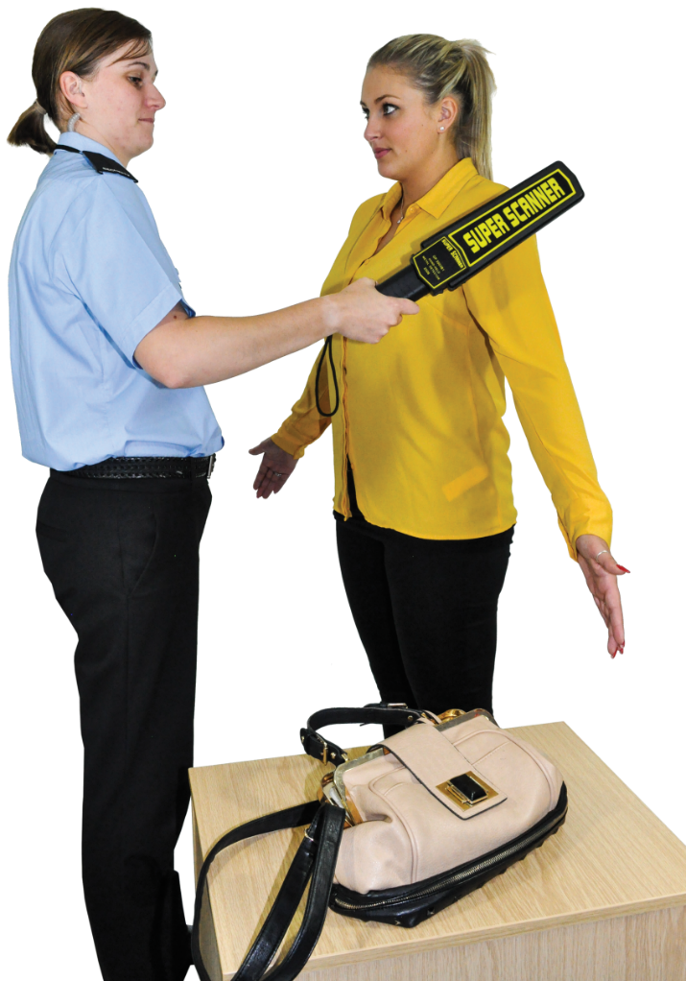
Searching people and their property
Search in a friendly, routine way
Try to reduce any feelings of
embarrassment that the person
might feel
Do not discriminate
Be polite and courteous
Talk to people as you search
them, to help make them
feel at ease
Search as quickly and as efficiently
as possible
Thank them for their assistance
afterwards.
Notes:
Searching people and their property
All searches should be carried out in a polite and courteous manner to avoid violent behaviour. Some people may feel intimidated or worried when being searched, whilst others may be used to it. You should talk to people as you search them, to help make them feel at ease, this gives you the opportunity to explain the search policy. You should try to carry out the search as quickly and as efficiently as possible, thanking them for their assistance afterwards.
All searches should be carried out it is important that consideration is given to protected characteristics identified in the Equality Act 2010 and the laws relating to discrimination in Northern Ireland.

Slide 12

Searching safely
Same sex searches
Search with another door supervisor to act as a witness
If you can, search within the view of CCTV
Be aware of:
needles/sharp objects
weapons
drugs
violence
infectious diseases
uncooperative clients
Consider having a dedicated area with search tables and PPE such as safety gloves.
Notes:
Searching safely
To prevent any false allegations of theft being made against you, you should always try to have another door supervisor or member of staff present during a search to act as a witness or in case of violence.
Same sex searches are still the legal benchmark, although there is guidance from the SIA regarding transgender people and that they should be allowed to be searched by their preferred gender.
If in doubt, self-searching is recommended, see next slide.

Slide 13
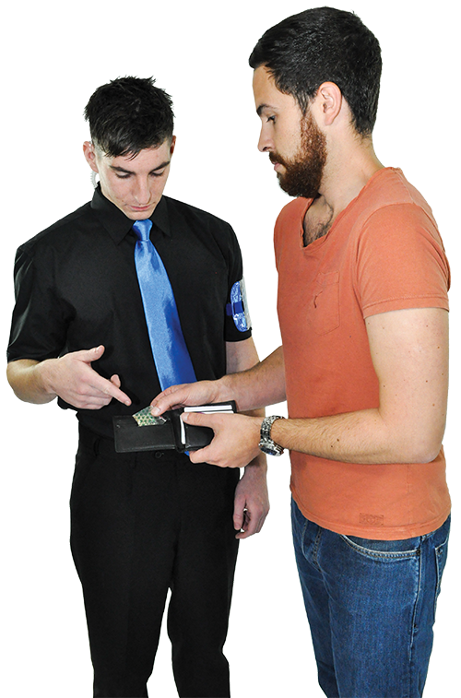
Searching safely cont.
Before you physically touch another
person, you should ask them:
for their permission
whether they have anything
that they should not have
whether they have anything
that could injure either
themselves or you
whether they have any
knives, needles or other
sharps in their possession.
Notes:
Someone who genuinely wants to hurt you will not be truthful with these questions.
Never assume they are telling you the truth.

Slide 14
Body searches
Body searches need to be made in a thorough and systematic way to ensure nothing is missed
You should devise your own method of searching and should use the same system every time so that you do not forget to search particular areas
KEY POINT
A good way to search is to start from the top at the front and work your way downwards, then move behind the subject to repeat the process.

Slide 15
Searching safely
Many venues that carry out regular searches now employ door supervisors of both sexes for this very reason. The SIA has produced a guidance document called ‘Trans customers: A guide for door supervisors’.
This can be located at:
www.sia.homeoffice.gov.uk/Documents/ sia-ds-transguide.pdf
Notes:
All searches must be carried out with consideration and respect for the person concerned. As a security operative, you should show sensitivity when searching transgender individuals.

Slide 16
Self-searching
If you have any concerns as to the gender or age of the person, then self-searching is a viable option
Ask the person to empty and turn out their pockets
Ask them to take off a jacket or to show you their waistband. Jackets can be checked once removed
Ask them to show you all other high-risk areas,
e.g. where jeans meet boots.
Notes:
Door supervisors cannot strip search anyone. They must only remove outer clothing.

Slide 17
Searching rooms or buildings
Outside areas, buildings or individual rooms within the venue may also need to be searched before opening and closing
Specific pre-entry searches may be carried out by a door supervisor to ensure the premises are safe and free from any hazards prior to customers entering
Lockdown procedures and closing checks should be carried out with the duty manager to ensure all doors and windows
are locked
Closing checks should ensure that no patrons are left in the toilets, VIP areas or areas which is easy to stow away (fall asleep).

Slide 18
Searching rooms or buildings cont.
Before conducting an area search you must
ensure you:
have sufficient support from colleagues to be able
to conduct a search efficiently, effectively and safely
have any necessary equipment with you to assist
in the search
have a suitable method of calling for assistance
if necessary.

Slide 19

Searching rooms or buildings cont.
Door supervisors may be required
to search for:
weapons
suspicious or missing people
criminal activity
suspect vehicles
suspect packages
signs of intrusion
stolen, missing or
damaged property
Search equipment may include: Search wands, metal detectors or archway metal detectors (AMDs).
Notes:
When searching rooms or buildings, door supervisors should:
know what they are looking for on each search
search pre-entry to ensure the room/building is safe to open to the public
search mid-shift to ensure no criminal activity or anything unusual is occurring
search at the end of shift/lockdown, ensuring no one left in the toilets, all doors are secure etc.
Equipment such as Search wands, metal detectors or archway metal detectors (AMDs) can be used.

Slide 20
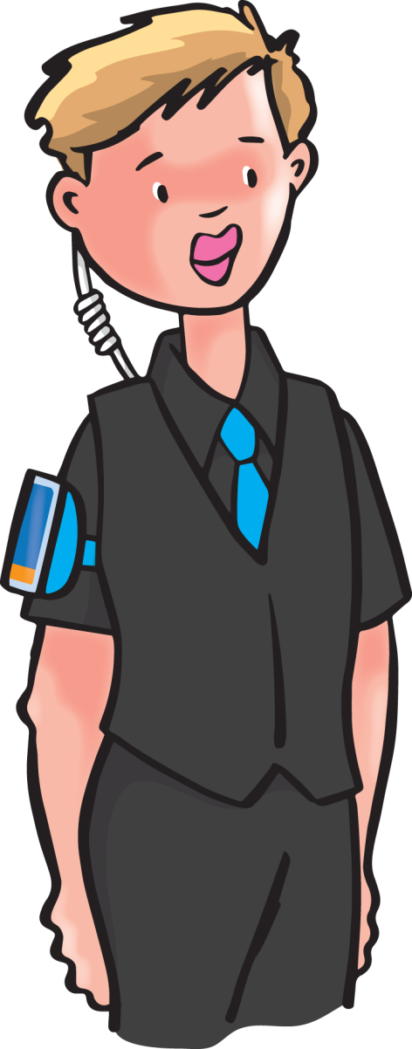

Search documentation
Proper search records help to:
ensure and show that search policies are being complied with
identify reasons for individual searches
protect security staff against malicious allegations
protect the person who is being
searched
act as evidence in criminal
proceedings.
Notes:
Search documentation
Venues that require the security team to search people or their property must provide a suitable method of recording searches, this may be the CCTV system.

Slide 21
Search documentation cont.
Search records should contain details such as:
day, date and time(s) of search
location of search
details of person searched
details of the door supervisor searching
(and any witnesses)
reason for search
details of search refusal
details of anything found during search
any action taken
signature(s).
Notes:
Search records
Most venues will provide door supervisors with a formal search register or book to record details of searches conducted at the premises.
Some venues require search details to be recorded on an incident report form or just by CCTV, unless an item is found and secured.
Search records are to be completed by the door supervisors and should contain the information highlighted in the slide.

Slide 22
Dealing with property found during a search
Any stolen, illegal, suspect or unauthorised items found must be dealt with correctly, following the venue’s search policy
The DPS should also be informed
Possible actions, depending on what is found and under
what circumstances, may include:
giving a verbal warning
reporting to your supervisor or line manager for advice
reporting to DPS for advice
looking after item for the customer until they leave
seizing item and refusing entry
seizing item, arresting customer and calling the police.
Notes:
Dealing with property found during a search
Action will be dependant upon the severity of the items found.
Different venues will have variable policies.
Door supervisors must follow their own venue’s policies.

Slide 23
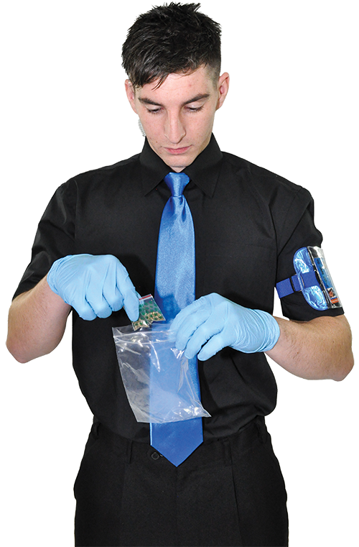
Dealing with property found during a search cont.
Any items seized must be:
kept securely (drugs amnesty box)
properly recorded
reported following the
local policy
Always follow the procedures
specified in the venue’s search
policy.
Notes:
Any items, including drugs that are seized, must be kept securely or placed in the drug amnesty box if available.
The items should then be properly recorded and reported following the local policy.
Door supervisors must always follow the procedures specified in their venue’s search policy.

Slide 24
Additional considerations
Care should be taken when dealing with people with physical or learning difficulties and with children or young people
Searches carried out on children and young people should be conducted in the presence of another individual
Children and young people should not be asked to remove clothing, other than outer garments like coats, gloves and hats
You should also be aware of other people’s cultural and religious beliefs and values, which may be slightly different to your own.
Notes:
Additional considerations
If door supervisors need to search a child or young person, they should first obtain the consent of a responsible adult.
The child or young adult must fully understand what is happening and why they are being searched. Searches should be conducted by a person of the same sex as the child or as the young person.

Slide 25
Incidents or accidents
As a door supervisor, you must record all incidents or accidents that occur during a search
You must complete an incident report form and the incident or accident should be reported to the person in charge as soon as possible
Emergency services should be contacted if needed
The venue’s policy/assignment instructions must always be followed.

Slide 26


Search demonstration/practical activity
Notes:
Group exercise
Demonstrate a search and then get learners to work in pairs, asking them to practice the different search methods.
Remember to record as per your awarding organisation requirements.

Slide 27

Key task 2
Key Task 2
1
Explain the THREE types of searches that can be carried out by a door supervisor.
…..................................................................................................................................................................................................................................................................................................................
1
2
3

Slide 28
Key task 2
Key Task 2
1
Explain the THREE types of searches that can be carried out by a door supervisor.
…........................................................................................................................................................................................................... .......................................................................................................
1
General
Random
Specific (Targeted)
2
3

Slide 29
Key task 2
Key Task 2
2
Identify THREE different types of search equipment.
…..................................................................................................................................................................................................................................................................................................................
1
2
3

Slide 30
Key task 2
Key Task 2
2
Identify THREE different types of search equipment.
…..................................................................................................................................................................................................................................................................................................................
1
Search wands
Archway metal detectors
Metal detectors.
2
3

Slide 31
Key task 2
Key Task 2
3
Explain the precautions a door supervisor
should follow when carrying out searches.
.................................................................................................................. ..................................................................................................................
..................................................................................................................
..................................................................................................................
..................................................................................................................

Slide 32
Key task 2
Key Task 2
3
Explain the precautions a door supervisor
should follow when carrying out searches.
Ask for their permission
Only search individuals of the same gender
Have a witness
Ask whether they have anything that could injure either themselves or you.
.................................................................................................................. ..................................................................................................................
..................................................................................................................
..................................................................................................................
..................................................................................................................

Slide 33

1.2
Terrorism
Notes:
Completion of this module will enable learners to meet the following learning outcome:
Learning outcome 9: Understand terror threats and the role of the security operative in the event of a threat
This includes assessment criteria:
9.1 Identify the different threat levels
9.2 Recognise the common terror attack methods
9.3 Recognise the actions to take in the event of a terror threat
9.4 identify the procedures for dealing with suspicious items
9.5 Identify behaviours that could indicate suspicious activity
9.6 Identify how to respond to suspicious behaviour
This module includes the following interactive activities:
Key task 9

Slide 34
Terrorism
Terrorism is the use of violence, threats and intimidation, especially in the pursuit of political aims.
Notes:
Terrorism
The use of violence, threats and intimidation, especially in the pursuit of political aims.

Slide 35
Terrorism cont.
Security operatives need to be aware of:
what is currently happening around the world and in their particular area
any recent terrorist attacks or threats
the location of their own site in relation to other possible targets nearby
where the site itself is famous or important in
its own right
the vulnerability of the site to attack
the current level of threat nationally.
Notes:
Public, commercial and retail premises, as well as places of entertainment could all become targets of either bomb threats or actual terrorist attacks.
Security operatives need to be aware of:
what is currently happening around the world and in their particular area
any recent terrorist attacks or threats
the location of their own site in relation to other possible targets nearby
where the site itself is famous or important in its own right
the vulnerability of the site to attack
the current level of threat nationally

Slide 36
National threat levels
THREAT LEVEL DEFINITIONS
CRITICAL - an attack is highly likely in the near future
SEVERE – an attack is highly likely
SUBSTANTIAL - an attack is likely
MODERATE - an attack is possible but not likely
LOW - an attack is highly unlikely.
Notes:
NATIONAL THREAT LEVEL DEFINITIONS:
CRITICAL- an attack is highly likely in the near future
SEVERE- an attack is highly likely
SUBSTANTIAL - an attack is likely
MODERATE - an attack is possible but not likely
LOW- an attack is highly unlikely
Threat levels themselves do not require specific responses, however it is important that security operatives are aware of the different response levels and what moving from one level to another means for the location they are working in and the plan that is in place.
www.mi5.gov.uk/threat-levels

Slide 37
Counterterrorism
Counterterrorism measures will help to reduce the chances of a site becoming a target. Threats can be reduced by:
vigilance
good housekeeping
use of physical security measures
regular, obvious patrols
use of strict access control procedures
effective search procedures
visible use of CCTV
the reporting of suspicions
to supervisors or managers immediately
know what information emergency response require and have an awareness of emergency response times.
Notes:
Counterterrorism reduces the chances of a site becoming a target. Threats can be reduced if security operatives:
are vigilant
maintain good housekeeping
use physical security measures
carry out regular, obvious patrols
implement strict access control procedures
use effective search procedures
visibly use CCTV
report suspicions to supervisors or managers immediately
It is important to know what information emergency response require and have an awareness of emergency response times.

Slide 38
Planning phase
Once terrorists have identified a target, the potential attack will be moved into the planning phase. This phase involves:
gathering information on the target
identifying the target’s vulnerabilities
identifying levels of security present at the target.
Notes:
By gathering information on the target, terrorists are able to decide their preferred method of attack.

Slide 39
Attack methods
The most current terrorist attack methods have included:
marauding terror attacks (MTAs)
explosive devices, including improvised explosive device (IED), person-borne improvised explosive device (PBIED), vehicle-borne improvised device (VBIED)
vehicle as a weapon (VAAW)
hazardous substances including chemical, biological
and radiological (CBR)
cyberattacks.
Notes:
Attack methods can vary and there may be instances where periods of training and rehearsals may precede the actual attack.
Marauding terror attacks (MTAs) can include the use of firearms, knives, blunt objects etc.
Vehicle as a weapon (VAAW) is also known as vehicle ramming.

Slide 40



Actions to take
The role you will be expected to take during a terror attack will be outlined in your organisation’s policies and procedures
You should encourage members of the public to:
RUN
HIDE
TELL
call 999 (response times may vary according to location).
to a place of safety
if you cannot run, hide
Notes:
In the rare event of a terror attack, security operatives should encourage members of the public to:
RUN – to a place of safety
HIDE – if you cannot run, hide
TELL – call 999 (response times may vary according to locations)

Slide 41
Run
In the event of an attack, you should:
consider your route
insist others go along with you (however, don't let their indecision slow you down)
once you have identified a safe route, RUN
Consider your route as you leave. Will it place you in the line of fire, is it safer to wait for the attacker to move away before you continue?

Slide 42
Hide
If you can’t move to safety - HIDE
When finding a hiding place, you should consider:
the exits and escape routes
rooms that have reinforced walls and doors with internal locks
moving away from the door
switching your phone to silent and switching off vibrate
staying silent (don’t shout for help).

Slide 43
Tell
If you are able to evacuate, get as far away
as possible and TELL
Call the police by dialling 999
TELL them clearly where you are located and where the attackers are
Give a clear description of the attackers, including details
of their clothing and weapons
Give details about the number of casualties
Explain the layout of the building
Include anything else that you think is important.
Notes:
Tell
If able to evacuate the premises, security operatives should stop others from entering and get as far away from the danger as possible (but only if this does not put them in danger).

Slide 44
Following procedures
Follow all invacuation/lockdown and evacuation procedures
Invacuation/lockdown -
staff members and members of the public should be moved
to the most sheltered area of the venue/site, away from windows and other exposed areas. All external doors and windows should be locked
Evacuation -
the orderly removal of staff and members of the public to a safe place away from the immediate vicinity of the building. Evacuation will normally happen in situations such as a fire.

Slide 45
Following procedures cont.
An early assessment of the situation is vital. If a terrorist attack begins outside, a quick lockdown procedure could protect everybody inside the site/venue
If lockdown is slow, incomplete or causes a state of confusion, the threat could move inside, putting the people inside at great risk.
Notes:
Following procedures during an attack can help preserve life.

Slide 46
Following procedures
 | Pros | Cons
Invacuation | Locks staff and members of the public away from the perpetrator, providing a physical barrier | Potential lack of exits limits the ability to run should the perpetrator gain access or the attack zone spreads
Evacuation | Allows staff and members of the public to get as far away as possible from the scene of the incident | Some evacuation routes may put staff and members of the public at risk of being in the line of fire, or the perpetrator may attempt to pursue along the evacuation route.
Notes:
Pros and cons for invacuation and evacuation

Slide 47
Suspicious packages
You need to be aware of suspicious packages and know the procedures to follow if one is identified
You need to know what looks out of place at the venue or site that you are working at
You can use the HOT protocol to help you determine whether items are suspicious.

Slide 48



Suspicious packages cont.
HIDDEN – has someone deliberately tried to conceal it from view?
OBVIOUSLY SUSPICIOUS – does its appearance seem odd or out of the ordinary? Maybe it’s even showing wires, batteries or liquids?
TYPICAL – is it typical for the location? For example, ae large rucksack would be expected at an outdoor festival but would be out of place at an indoor concert venue.

Slide 49
Suspicious packages cont.
Suspicious items should be treated with caution
Don’t touch the item
Move yourself and others a safe distance from the item
Clear 100m around the object
Large items or small vehicles need a clear area of around 200m
Large vehicles need a clear area of 400m or the length
of a football pitch.
Notes:
Safety distances:
distances v suspicious item size:
small items: 100m
large items or small vehicles: 200m
large vehicles: 400m or the length of a football pitch
How to visually represent safety distances e.g. football field/London bus.

Slide 50

Suspicious packages cont.
Keep yourself and others out of line of sight
If you can’t see the item then you’re better protected from it
THINK ABOUT
what you can hide behind, find something
substantial and keep away from glass, such
as windows and skylights.

Slide 51

Suspicious packages cont.
Inform the relevant people as well as the police
Don’t use communication devices within 15m of the item
Remember, some explosives can be triggered
by the signal from a radio or mobile phone.
Notes:
Inform relevant people:
manager
supervisor
the police
Don’t use radios or mobile phones around suspicious packages as they may trigger explosives . Keep a distance of 15m when using communication devices.

Slide 52





Suspicious packages cont.
Remember the 4 Cs:
Confirm if the package is suspicious
Clear the area as best you can
Communicate to your team and the police
Control others getting into that area.
Notes:
The four C ‘s:
Confirm
Clear
Communicate
Control

Slide 53
Suspicious activity
Suspicious activity is any observed behaviour that could indicate terrorism or terrorism-related crime
Security operatives need to be familiar with the different methods of observing suspicious activity including:
people
places
vehicles
locations.
Notes:
Suspicious activity is any observed behaviour that could indicate terrorism or terrorism-related crime.
Security operatives need to be familiar with the different methods of observing suspicious activity, including:
people
places
vehicles
locations

Slide 54
Suspicious activity cont.
Hostile reconnaissance is the term used to describe
how terrorists gain information on potential targets
They will often:
visit potential targets a number
of times prior to an attack
try to find out as much as they
can about the location itself
try to discover the best time and method of attack
You need to be vigilant at all times to try and recognise suspicious behaviour that may indicate a terrorist interest in your site.
Notes:
You should use your customer service skills to disrupt potential hostile reconnaissance, having a professional, visible presence is a tool that all security operatives can use to deter hostile reconnaissance.

Slide 55
Suspicious behaviour
Suspicious behaviour may include:
a particular interest in the outside of the site
an interest in the CCTV systems
taking pictures of the site (overtly or covertly)
making notes or drawing diagrams of the site
taking an interest in the timings of activities
false alarm activations (testing response times)
damage to perimeter security
attempts to disguise identity (hats and hoods)
trespassing or loitering with no good reason
asking unusual/specific questions about the site or security arrangements
nervousness
reluctance to be noticed or seen
use of forged/fake identity documents
strangely parked vehicles.
Notes:
Suspicious behaviour may also include:
an interest other security measures that are in place (as well as CCTV)
parked vehicles with people inside
empty parked vehicles left unattended for long periods
making unusual requests for information
individuals avoiding security staff
breaching restricted areas
inappropriately dressed for the season/location
individuals carrying out activities inconsistent with the nature of the building or area
multiple sightings of the same suspicious person, vehicle or activity
carrying large amounts of cash

Slide 56
Responding to suspicious behaviour
Don’t be afraid to take action, have the confidence to ACT
Dial 999 if it is a life-threatening emergency and provide the operator with the following information:
your place of work and the specific building
location of the suspicious package inside the building
whether all customers and employees have been evacuated from the building.

Slide 57

Reporting
Non-urgent information about terrorism should
be passed to the anti-terrorist hotline on
0800 789321
This line is covered at all times by specialist counterterrorism police officers
Urgent information should be passed on using
999
Report online https://act.campaign.gov.uk/
non-emergency, call 101.
Notes:
Non-urgent information about terrorism should be passed to the anti-terrorist hotline on 0800 789321. This line is covered all the time by specialist counterterrorism police officers
Urgent information should be passed using the 999 system
Report online https://act.campaign.gov.uk/
Non-emergency, call 101

Slide 58



Responding to suspicious behaviour
See it
Say it
Sorted
The British Transport Police’s nationwide campaign, designed to encourage train passengers and people visiting train stations to report any unusual items or activity. Passengers and visitors can report any issues by texting 61016 or by calling 0800 405040.

Slide 59
Current initiatives
See, Check and Notify
A current awareness strategy that aims to help businesses and organisations maximise safety and security using their existing resources
Action Counters Terrorism (ACT) Awareness - elearning
This is a free course to access via:
https://ct.highfieldelearning.com/
Notes:
Current initiatives
See, Check and Notify is a current awareness strategy that aims to help businesses and organisations maximise safety and security using their existing resources.
ACT awareness e-learning has been developed to support the United Kingdom’s strategy for countering terrorism. This e-learning provides nationally recognised corporate CT guidance to help people better understand and mitigate against counter-terrorist methodology. ACT e-learning https://ct.highfieldelearning.com/

Slide 60
Counterterrorism experts
Additional information, advice and guidance can be found with the following sources:
Centre for the protection of National infrastructure (CPNI)
www.cpni.gov.uk/cpni-context
National Counter Terrorism Security office (NaCTSO)
www.gov.uk/government/organisations/national-counter-terrorism-security-office.
Notes:
For additional support and guidance, signpost to:
CPNI website
NaCTSO website

Slide 61

Action counters terrorism

Slide 62
Key Task 9
1
What are the FIVE different threat levels?
….........................................
….........................................
….........................................
1
….........................................
….........................................
4
2
5
3
Notes:
Ask delegates to complete the key tasks for this section in their handouts, or to complete it in groups in the classroom.

Slide 63
Key Task 9
1
What are the FIVE different threat levels?
Critical
Severe
Substantial
Moderate
Low.
….........................................
….........................................
….........................................
1
….........................................
….........................................
4
2
5
3

Slide 64
Key Task 9
2
What are the most common terror attack methods?
..................................................................................................................
..................................................................................................................
..................................................................................................................
..................................................................................................................
..................................................................................................................
..................................................................................................................
Notes:
Ask delegates to complete the key tasks for this section in their handouts, or to complete it in groups in the classroom.

Slide 65
Key Task 9
2
What are the most common terror attack methods?
..................................................................................................................
..................................................................................................................
..................................................................................................................
..................................................................................................................
..................................................................................................................
..................................................................................................................
Marauding terror attack
Explosive devices
Vehicle as a weapon
Hazardous substances
Cyberattacks.

Slide 66
Key Task 9
3
Identify behaviours that could indicate
suspicious activity and explain how you
would respond to the activity you have identified.
..................................................................................................................
..................................................................................................................
..................................................................................................................
..................................................................................................................
..................................................................................................................
..................................................................................................................
Notes:
Ask delegates to complete the key tasks for this section in their handouts, or to complete it in groups in the classroom.

Slide 67
Key Task 9
3
Identify behaviours that could indicate
suspicious activity and explain how you
would respond to the activity you have identified.
..................................................................................................................
..................................................................................................................
..................................................................................................................
..................................................................................................................
..................................................................................................................
..................................................................................................................
Particular interest in the outside of the building
An interest in the CCTV systems and other security measures
Asking unusual questions or very specific questions about the site
or security arrangements.
Notes:
This list is not exhaustive.
In all cases report to line manager, supervisor or venue manager or use the confidential anti-terrorist hotline.
If life threatening call 999.

Slide 68

1.3
Keeping vulnerable
people safe
Notes:
Completion of this module will enable learners to meet the following learning outcome:
Learning outcome 10: Understand how to keep vulnerable people safe
This includes assessment criteria:
10.1 Recognise duty of care with regard to vulnerable people
10.2 Identify factors that could make someone vulnerable
10.3 Identify actions that the security operative should take towards vulnerable individuals
10.4 Identify behaviours that may be exhibited by sexual predators
10.5 Identify indicators of abuse
10.6 State how to deal with allegations of sexual assault
10.7 State how to deal with anti-social behaviour
This module includes the following interactive activities:
class question: What behaviours might indicate a sexual predator?
class question: What behaviours might indicate abuse?
class question: What is anti-social behaviour?
Key task 10

Slide 69

Vulnerable people
Security operatives have a duty of care for all individuals on their premise but particularly for vulnerable people
Duty of care is defined as:
‘a moral or legal obligation to ensure the health,
safety and welfare of others.’
It can be difficult to tell who is and who is not vulnerable, so best practice is to have a duty of care for everyone.
Notes:
Discuss the difference between moral and legal obligations and when they might apply.
Employers have a moral and legal duty under the Health and Safety at Work etc. Act 1974.

Slide 70
Vulnerable people cont.
Vulnerable people may be:
under the influence of drink or drugs
alone or receiving unwanted attention
separated from friends
appearing lost or isolated
being followed or threatened
victims of domestic violence
young people under the age of 18
being elderly.
Notes:
Vulnerable people
As part of customer service and their roles in protecting people from harm, security operatives need to be aware of any people who may be classed as vulnerable (people who may be at more risk of harm than others).
Security operatives need to carefully consider the implications for vulnerable children and young adults either passing or leaving venues/sites. They need to consider whether they require medical attention, whether they have friends/family nearby and whether they have all of their belongings with them.
They need to question whether they appear to fit into any of the above categories.
Security officers need to look out for the following behaviours from vulnerable people under the following categories:
drink/drugs – reduced inhibitions, over-friendly, uncoordinated, aggressive, inability to make informed decisions, unaware of own abilities/limitations
alone/unwanted attention – distressed, being followed/threatened

Slide 71
Vulnerable people
Vulnerable people may also:
have mental ill health
have learning disabilities
have physical disabilities
be elderly
be acutely ill
have invisible disabilities.
Notes:
Invisible disabilities – physical, mental or neurological conditions that limit a person’s movement, senses or activities that are invisible to the onlooker.

Slide 72
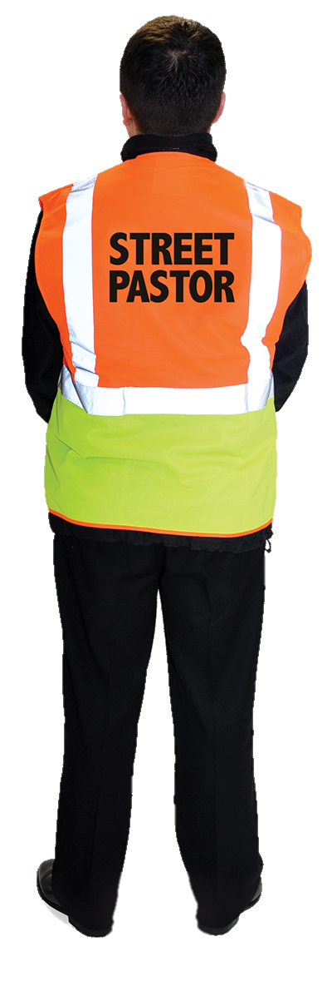
Actions towards vulnerable people
Consider
Is there a relative or friend nearby to help them?
Can you telephone anyone to come and help
them?
Are there any local safe havens or safety
initiatives nearby?
Can local street marshals, street pastors
or similar groups help them?
Do you need to call the emergency services?
If in any doubt whatsoever, report as soon as possible
to your supervisor, the police or call crimestoppers.
Notes:
Actions towards vulnerable people
In your professional judgement, if they appear to be vulnerable, you need to consider what help they might need.
Local safe havens/safety initiatives – e.g. those run by St John Ambulance or ‘Ask Angela’.

Slide 73
Indicators of child sexual exploitation
There are certain indicators that a child is being sexually exploited such as:
children and young people in the company of older people or antisocial groups
acting in an inappropriate and sexualised way
being intoxicated arriving and departing a location with different adults
getting into and out of several different cars
You must be vigilant at all times if you suspect a child is being sexually exploited, you must report it immediately and follow the organisation’s policies and procedures.

Slide 74
Sexual predators
Sexual predators are those who commit sexual crimes
They very often target vulnerable children, young adults
or adults they think they can groom or overpower
They can be all genders, shapes and sizes
They will often appear to be confident, friendly,
helpful and sober.
Notes:
Effective sexual predators do not seem to be a predator to the victim.

Slide 75
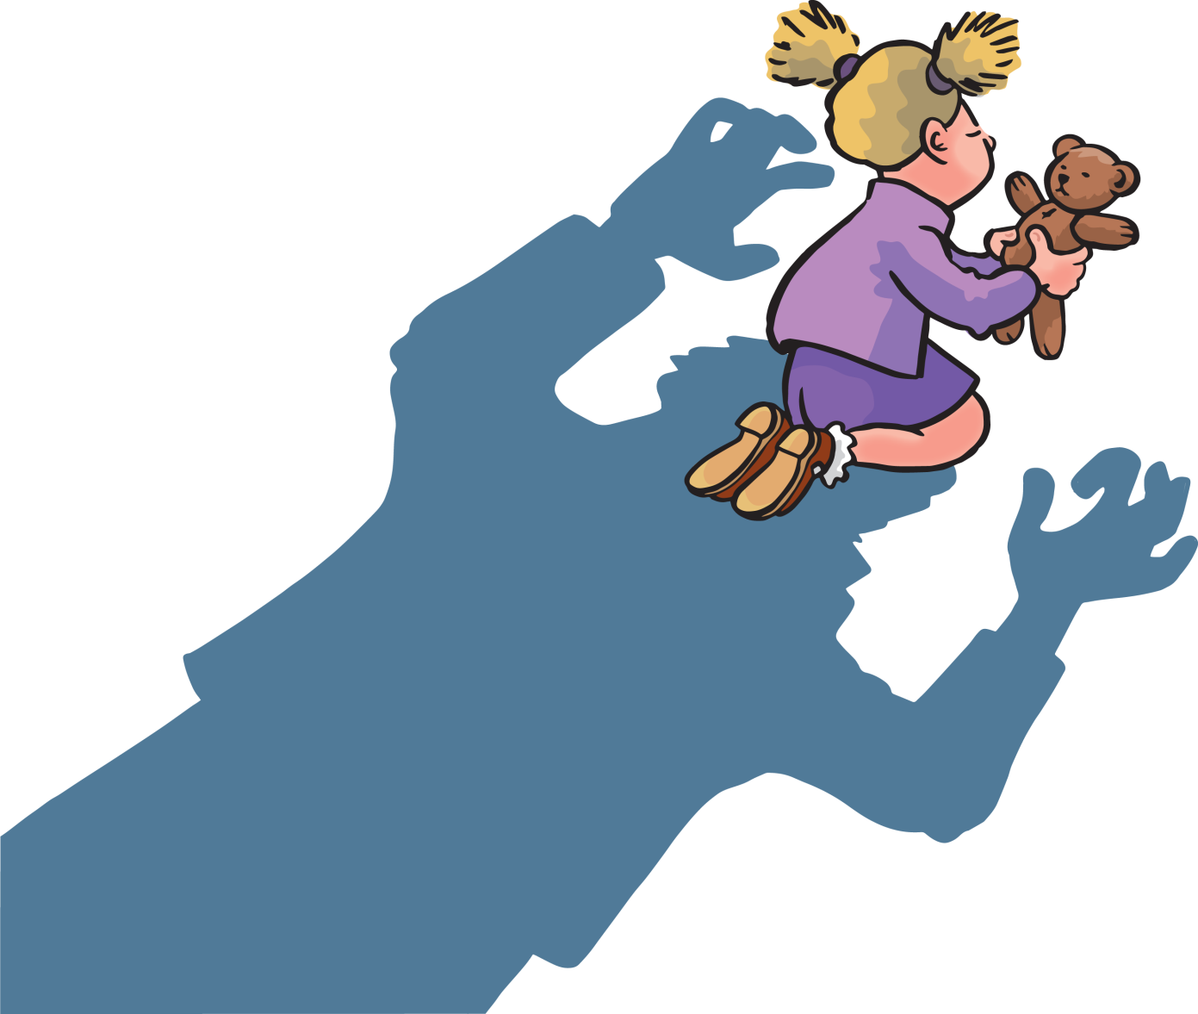
Sexual predators cont.
Sexual predators may select their victims based on:
gender
age
race
vulnerability
appearance
location
time of day.
Notes:
Sexual predators may have a preference as to who they target.
This may be a sexual preference alone or an additional factor such as young or intoxicated.

Slide 76

What behaviours might indicate a sexual predator?
Close monitoring of vulnerable people
Buying drinks for already drunk individuals
Buying gifts for vulnerable people
Suspicious behaviour around certain times and venues
Inappropriate use of technology.
Notes:
Class question: What behaviours might indicate a sexual predator?
Sexual predators
Security operatives must be able to identify the behaviours that may be exhibited by sexual predators.
It is important that learners remember that sexual predators don’t look just one particular way, but are all genders, shapes and sizes.
Re. buying gifts for vulnerable people – sexual predators may give gifts to those in poor/unsettled homes, e.g. offering to share a gaming console with a financially poor person or offering refuge during a divorce.
Re. suspicious behaviour around certain times/venues – venues could include schools/play areas/pubs/clubs etc.
Re. inappropriate use of technology – predators could use phones, for example, to upskirt (taking a photograph underneath a woman’s skirt/dress without her consent).

Slide 77
What behaviours might indicate abuse?
Restricting the freedom of an individual
Unexplained bruising
Lack of confidence and insecurity
Change in circumstance, e.g. cleanliness/appearance.
Notes:
Class question: What behaviours might indicate abuse?
Indicators of abuse
Abuse can be mental as well as physical, so an abuser may be able to both mentally and physical restrict an individual’s freedom.
Unexplained bruising may be clearly visible to security operatives, however individuals may be able to keep their bruises/injuries hidden.
Security operatives may be able to pick up on a change in personality/circumstance from a regular customer or colleague which could be indicating that mental or physical, or both types of abuse are occurring. Changes in personality/circumstance could be for the better or worse.

Slide 78
Allegations of sexual assault
Follow your organisation’s policies and procedures
Safeguard the victim by making sure they
have a safe space to stay
Inform your manager or supervisor as soon as possible
Notify the police
Record and document all information at the first opportunity.
Notes:
Allegations of sexual assault
Security operatives regularly wear uniforms. Some people find this reassuring and may choose to tell the operative about the abuse that they have been subjected to. This is called a disclosure.
Every organisation has a policy on what action to take if a member of staff or customer discloses information to them. Security operatives must follow the procedures when dealing with allegations of sexual assault. They must in the first instance:
safeguard the victim by making sure they have a safe space to stay that is separate from the assailant
inform their manager/supervisor as soon as possible
notify the police
record and document all information at the first opportunity

Slide 79



What is anti-social behaviour?
There are 3 main categories for anti-social behaviour, depending on how many people are affected
Personal antisocial behaviour - when a person targets a specific individual or group
Nuisance antisocial behaviour - when a person causes
trouble, annoyance or suffering to a community
Environmental antisocial behaviour - when a person’s actions affect the wider environment, such as public spaces or buildings.
Notes:
Class question: What is anti-social behaviour?
Anti-social behaviour
Security operatives should always try to be positive and productive in their attitudes when dealing with members of the public that are demonstrating anti-social behaviour.
Source https://www.thamesvalley.police.uk/advice/advice-and-information/asb/af/antisocial-behaviour/
Simplify to bullying, graffiti, etc.

Slide 80
How to deal with anti-social behaviour
Follow your organisation’s policies and procedures
Speak to the person
Explain the situation and the risks of the anti-social behavior
Explain the consequences if the anti-social behavior continues
Remain calm
Ensure that your colleagues know about the situation
and that you have back-up if needed
Remain vigilant.
Notes:
Anti-social behaviour
Further ways in which to deal with anti-social behaviour are detailed on the next slide.

Slide 81
How to deal with anti-social behaviour cont .
Conduct high-profile patrols
Promote early intervention
Use positive, non-aggressive communication
Promptly report incidents
Accurately record incidents
Liaise with police and other appropriate agencies.

Slide 82
Key Task 10
1
Identify FIVE factors that could make someone vulnerable.
….........................................
….........................................
….........................................
1
….........................................
….........................................
4
2
5
3
Notes:
Ask delegates to complete the key tasks for this section in their handouts, or to complete it in groups in the classroom.

Slide 83
Key Task 10
1
Identify FIVE factors that could make someone vulnerable.
Drink
Drugs
Alone
Victim of domestic violence
Young people (under 18).
….........................................
….........................................
….........................................
1
….........................................
….........................................
4
2
5
3

Slide 84
Key Task 10
2
Identify behaviours that may be exhibited by sexual predators.
..................................................................................................................
..................................................................................................................
..................................................................................................................
..................................................................................................................
..................................................................................................................
..................................................................................................................
Notes:
Ask delegates to complete the key tasks for this section in their handouts, or to complete it in groups in the classroom.

Slide 85
Key Task 10
2
Identify behaviours that may be exhibited by sexual predators.
..................................................................................................................
..................................................................................................................
..................................................................................................................
..................................................................................................................
..................................................................................................................
..................................................................................................................
Close monitoring of vulnerable people e.g. someone looking lost or alone
Buying drinks for people who are already intoxicated.
Notes:
This list is not exhaustive

Slide 86
Key Task 10
3
Identify indicators of abuse.
…....................................................................................................
…....................................................................................................
…....................................................................................................
…....................................................................................................
1
2
3
4
Notes:
Ask delegates to complete the key tasks for this section in their handouts, or to complete it in groups in the classroom.

Slide 87
Key Task 10
3
Identify indicators of abuse.
Restricted freedoms of individuals
Unexplained bruising
Lack of confidence and insecurity
Change of personal circumstances.
…....................................................................................................
…....................................................................................................
…....................................................................................................
…....................................................................................................
1
2
3
4

Slide 88
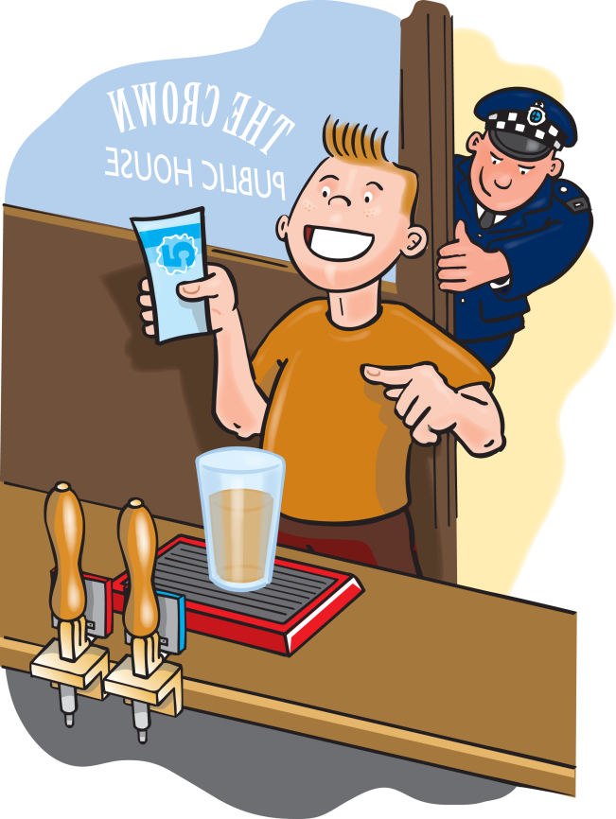
1.4
Spiking Drinks

Slide 89
Understanding Spiking
What is Spiking?
Definition:
  Adding alcohol or drugs to someone’s drink without their knowledge.
  Injecting someone with drugs without their consent (needle spiking).

Slide 90
Key Facts
Who can it happen to?
  Anyone, anywhere.
Who can do it?
  Strangers or people you know.
Legal consequences:
  Criminal offenses with potential sentences of up to 10 years in prison, even if no other crime occurs.

Slide 91
Signs of Being Spiked
Changes in drink appearance or taste.
Feeling unusually drunk or strange.
Physical signs:
  Confusion and poor coordination.
  Nausea or vomiting.
  Unconsciousness.
Mental effects:
  Hallucinations and paranoia.
  Loss of ability to communicate.

Slide 92
Actions to Take
If You or Someone Else is Spiked:
Alert staff or security at the venue.
Stay with your friends and keep them talking.
Report to the police:
  Call 101 or dial 999 in emergencies.
If Symptoms Appear:
  Call 111 for medical advice.
  Call an ambulance if symptoms worsen.
  Visit a Sexual Assault Referral Centre (SARC) for support in case of suspected sexual assault.

Slide 93
Police Reporting and Evidence Collection
Reporting process:
  Officers may take a non-invasive urine sample.
  Testing should happen as soon as possible, ideally within 12 hours.
Important notes:
  Some drugs remain in the body for up to 7 days.
  Illegal drugs in your system are not a crime, except when driving.
Test results:
  Available within 3 weeks.
  Police will update and support you.

Slide 94
How to Reduce the Risk of Spiking
Tips for Staying Safe:
Look out for your friends and stay together.
Never leave your drink unattended.
Accept drinks only from people you know and trust.
Alert staff immediately if suspicious activity is noticed.
If You or a Friend Feels Unwell:
Seek help from venue staff or call an ambulance immediately.

Slide 95
The important things to do now are…
1
    to put into practice what you have learnt
2
  to develop competency in your work activities
3
  to keep your knowledge up to date
4
  to pass the examination.
Thank you for listening

